Slide 1


Operation of Unmanned
Aircraft System
Module 4, Module 5 and Module 6

Slide 2

040 00 00: Navigation & Meteorology
Module 4

Slide 3

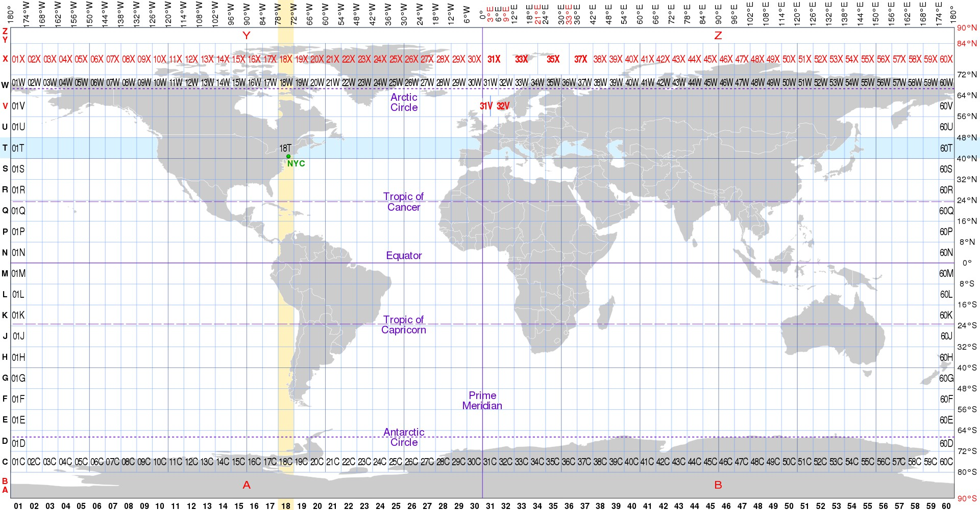
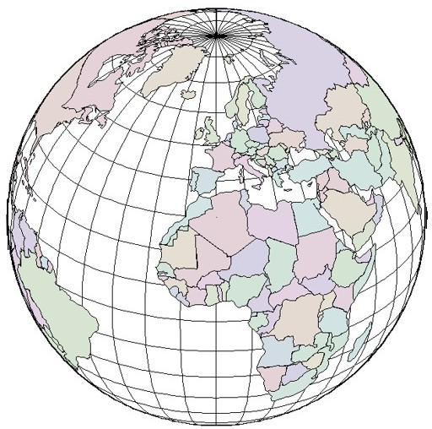



040 01 00: Navigation
040 01 01: Geographic coordinate system used in basic navigation
UTM map projection
Universal Transverse Mercator (UTM) is a projection, designed to display features on a two dimensional surface (i.e. Map).
48N
East to West, cells are labelled from 1 to 60, and centered over Greenwich, England South to North are labelled from C to X
Notes:
UTM Map Projection
UTM = Universal Transverse Mercator
A map projection that shows features on a flat, two-dimensional surface.
Converts the curved surface of the Earth into a grid system for easier navigation and mapping.
Commonly used in aerial surveying, mapping, and navigation.
UTM Grid System
Zones (East–West):
Numbered 1 to 60
Each zone spans 6° of longitude
Zone 1 is centered over Greenwich, England
Latitude Bands (South–North):
Lettered C to X (omitting I and O)
Each band spans 8° of latitude
Purpose:
Combines zone number + latitude band to locate positions on the map
Simple summary for students
East–West = numbered zones (1–60)
South–North = lettered bands (C–X)
Together, they form a grid system for accurate positioning

Slide 4
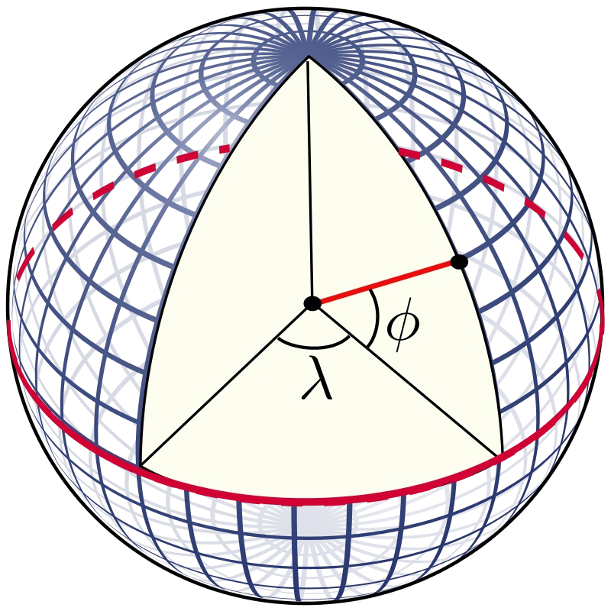
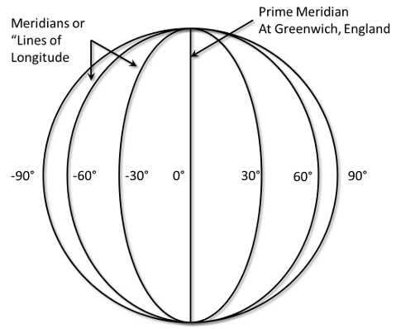
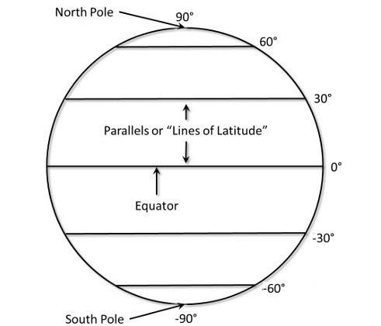
Latitude and longitude
Is use to locate features on a three dimensional surface (i.e. Earth).
Both longitude and latitude are angles measured with the center of the earth as an origin.
A longitude is an angle from the prime merdian, measured to the east (longitudes to the west are negative).
Latitudes measure an angle up from the equator (latitudes to the south are negative).
Figure 1. With an angle of longitude and an angle of latitude, we can locate any point on the surface of the earth.
Figure 2. Meridians or "Lines of Longitude" and degree readings for longitudes in increments of 30 degrees.
Figure3. Parallels or "Lines of Latitude" and degree readings for latitudes in increments of 30 degrees.
The word geospatial is used to indicate that data that has a geographic component to it. This means that the records in a dataset have locational information tied to them such as geographic data in the form of coordinates, address, city, or ZIP code. GIS data is a form of geospatial data. Other geospatial data can originate from GPS data, satellite imagery, and geotagging.
4
Notes:
Latitude and Longitude
Latitude
Measures the distance north or south of the Equator
Runs horizontally around the Earth
Values range from 0° at the Equator to 90° at the poles
Longitude
Measures the distance east or west of the Prime Meridian
Runs vertically from pole to pole
Values range from 0° at Greenwich, England to 180° east or west

Slide 5
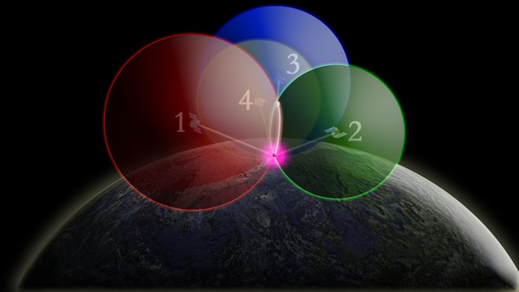
040 01 02: Concept of Global Navigation Satellite System:
How GPS works?
GPS is a constellation of satellites that orbit approximately 11,000 miles above the Earth and transmit radio wave signals to receivers across the planet. By determining the time that it takes for a GPS satellite signal to reach your receiver you can calculate your distance to the satellite and figure out your exact location on the Earth.
It takes four GPS satellites to calculate a precise location on the Earth using the Global Positioning System: three to determine a position on the Earth, and one to adjust for the error in the receiver's clock. If you were 15,000 miles from only one satellite (satellite with red sphere), you could be anywhere on an imaginary red sphere that has a radius equal to the number of miles from the satellite (15,000 miles).
When you add a second satellite (satellite with green sphere), about 12,000 miles away, you can only be where these two imaginary spheres intersect (the white circle).
When you add a third satellite (satellite with a blue sphere) you can come close to finding your exact position on the Earth. Imagine that you are 14,000 miles from the third satellite. In this situation, there are only two points (the two white points) where you could possibly be. These points are where the 14,000-mile sphere intersects with the 15,000-mile and 12,000-mile spheres.
To correct for the GPS receiver's clock error and find your precise position, a fourth satellite (satellite with the yellow sphere) must be used. With the fourth satellite, small timing errors from all four satellites to the point on the Earth have been adjusted, and your exact location on the Earth (the purple point) can be determined.
5
Notes:
How GPS Works
GPS = Global Positioning System
Constellation of satellites orbiting ~11,000 miles above Earth
Satellites transmit radio signals to GPS receivers on the ground
How Location is Calculated
Distance to Satellite
The GPS receiver measures how long it takes for the signal to reach it
This gives the distance to each satellite
Triangulation with Multiple Satellites
1 satellite: You could be anywhere on an imaginary sphere at that distance
2 satellites: Your position is where the two spheres intersect (circle)
3 satellites: Only two points possible where the three spheres intersect
4 satellites: Required to correct the receiver’s clock error and pinpoint exact location
Simple summary for students
GPS measures distance from satellites
Uses 3 satellites to locate position
4th satellite corrects clock error for precise location

Slide 6
Basic principles of operation and common errors
All GNSS systems comprise many satellites orbiting the Earth at very high elevations. At a single point in time, there will be several satellites from which a receiver may have a clear line of sight to receive signals and build its own navigation solution. However, these signals are prone to several sources of disturbance, causing errors in the measurements that are generated inside the receiver, which in turn degrades positioning accuracy.
Error sources and consequences
GNSS signals have very low power, and hence they are prone to several sources of noise and errors. The range measured by the GNSS receiver is contaminated by these errors, which is why it is called the pseudorange.
Clock-related errors - Receivers generate measurements based mainly on measuring time. Indeed, time is central to GNSS systems; therefore, GNSS satellites are equipped with very precise, and hence very expensive, clocks. Despite their accuracy, satellite clocks still drift slightly from GNSS time.
Satellite clock errors - There are three factors that can affect GNSS satellite clocks: stability, relativistic effects, and timing group delay.
Receiver clock errors - GNSS receivers are equipped with inexpensive crystal clocks, which have low accuracy compared to satellite clocks. As a result, the receiver clock error is much larger than that of the GNSS satellite clock. There are two ways to fix this issue. One is to use external precise, usually cesium or rubidium, clocks which have superior performance, but the problem is that they are very expensive
iii.
Intersystem biases - One way to enhance the accuracy and the availability of the GNSS receiver solution is to use all the observations from all available GNSS constellations. GPS and the Russian global navigation satellite system, GLONASS, are currently fully operational systems with global coverage, while other systems are now evolving to achieve the worldwide coverage such as the European Galileo and the Chinese BeiDuo systems. Each GNSS has its own timing system, and hence, there are some intersystem clock biases that should be considered when dealing with a multi-constellation system.
6

Slide 7
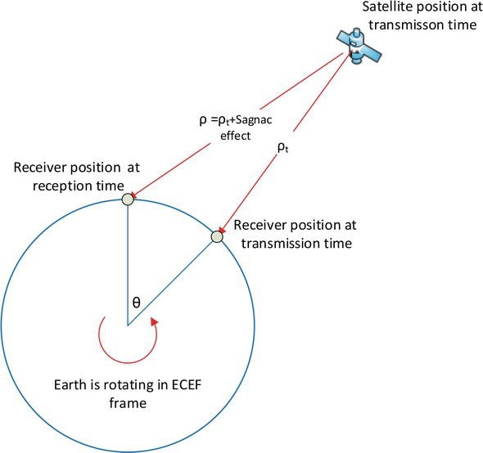
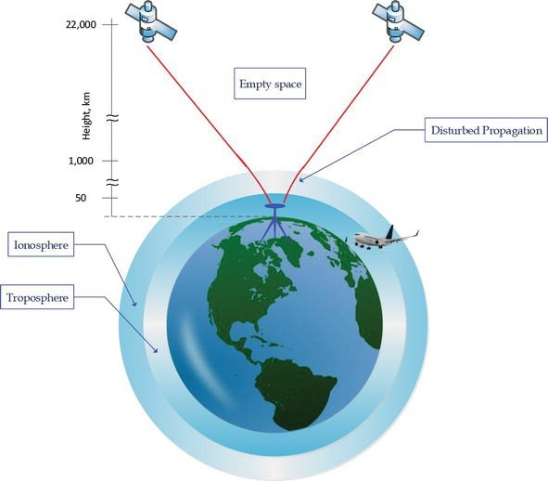
Signal propagation errors - During signal propagation time, the Earth would have rotated, causing a relative shift between the satellite and receiver locations at signal transmission time and signal reception time. If not accounted for, this relative distance, known as the Sagnac effect, will cause an extra error in the measured range.
Sagnac effect -The Sagnac effect is a relativistic error caused by the Earth’s rotation during signal propagation time between the satellite and the receiver. Ephemeris parameters obtained from the navigation message provide information about the satellite position expressed in the Earth-centered Earth-fixed (ECEF) frame at signal transmission time. However, during signal transit time, the Earth would have rotated (see Figure 1) and, hence, the ECEF frame; consequently, a correction is needed to express the satellite position in the ECEF frame at signal reception time instead of transmission time .
ii. Ionosphere errors - When the signal reaches an altitude of about 1000 km above the Earth’s surface, it penetrates the upper layer of the atmosphere, namely, the ionosphere (see Figure 2). This layer of atmosphere includes various types of gases that are readily ionized by the sun’s radiation. The intensity of solar activity is the key factor determining the condition of the ionosphere, but it is also affected by season and time of day. Accordingly, these three parameters define the level of ionization, thereby changing the refractive indices of the layers of the ionosphere, therefore, influencing the signal transit time measured by the receiver.
(Figure 1)
iii.
Troposphere errors - The next step is for the signal to move through the troposphere, the lowest part of the atmosphere, extending from the Earth’s surface up to a maximum height of 20 km above sea level (see Figure 2). This part of the atmosphere is composed of dry gases and water vapor. Since it is a refractive layer, the troposphere, too, delays GNSS signals; however, being electrically neutral, this layer is nondispersive for some GNSS frequencies. The tropospheric delay has two components: wet and dry. The wet one is difficult to model, but luckily, it accounts for only 10 percent of the delay. The dry one, which is responsible for the rest of the delay, can be more easily modeled. The tropospheric delay is frequency independent; therefore, unlike the ionospheric delay, it cannot be removed by combining measurements from L1 and L2 GPS signals. Depending on satellite elevation, the tropospheric delay adds up about 2.5 m to 25 m to range measurements
(Figure 2)
7

Slide 8
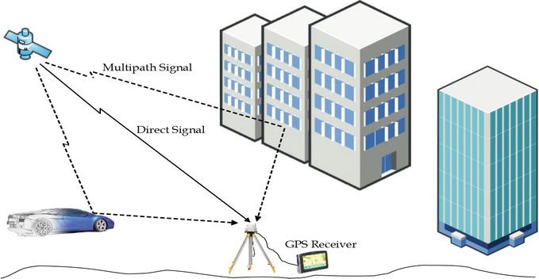
iv. Multipath errors - As the signal nears the receiver antenna, it can often be further degraded. In several scenarios, the signal may reach the receiver’s antenna via more than one path (see Figure 3), owing to signal reflections from surrounding structures or the ground. Usually, one of the received signals would be the direct line-of-sight (LOS) signal, along with one or more of its echoes, which are delayed versions of the original signal. Those delayed versions are superimposed on the LOS signal, which can significantly distort the desired LOS signal. The multipath effect depends on the surrounding environment and the relative satellite-receiver motion. Moreover, in general, this effect cannot be canceled through differential positioning—even for closely spaced receivers. Therefore, the multipath error can limit positioning accuracy even if the other error sources have been removed. In the most severe conditions, the multipath error can cause a pseudorange error of up to 100 m
(Figure 3)
System errors - Some GNSS errors result from the overall nature of the system, e.g., the shape of orbital planes and receiver structure.
Satellite orbital errors - Receivers calculate satellite position based on information contained in the navigation message known as satellite ephemeris. These ephemeris parameters are estimated at the control segment and then uploaded to satellites. Satellites broadcast updated ephemeris data every 2 hours; however, these parameters are estimated using a curve fit to predict the satellite orbit, which leaves residual errors relative to the actual orbit.
Receiver noise - Receiver noise is a complex error generated at the receiver’s side while measuring satellite signals. It covers a broad spectrum of noise types, including but not limited to microwave radiations sensed by the antenna in the band of interest unrelated to the signal; noise introduced by system components such as the antenna, cables, and amplifiers; and signal quantization noise. Receiver noise is considered white noise; therefore, it cannot be avoided entirely.

Slide 9
Intentional error sources - Some GNSS error sources are deliberate, i.e., imposed by the service provider or an attack on the system.
Selective availability - Selective availability is associated with only the GPS system among all the GNSS systems. Selective availability (SA) was an intentional degradation of GPS performance by the US government for national security reasons. Satellite clock corrections in the broadcast ephemeris were deliberately degraded to reduce the accuracy for civilian use of GPS to an accuracy level of 100 m for the horizontal position. However, on 2 May 2000, this feature was discontinued, and the USA announced that it would no longer impose this. Furthermore, the new generation of GPS satellites (GPS III) will not have this feature, meaning that SA cannot be used by the US government anymore.
Signal jamming - Intentional interference is, in many cases, a significant source of GNSS signal degradation. Intentional interference, known as signal jamming, is caused by the broadcast of malicious radio frequency (RF) signals to prevent GNSS receivers in the area from tracking GNSS signals. The typical direct consequences of jamming are signal frequency shifts in Hertz (Hz) and a drop in signal power in decibels (dB). These effects, in turn, have the potential to cause severe errors in position, velocity, and time calculations and even completely freeze the receiver causing a denial of service condition.
iii.
Signal spoofing - GNSS signal spoofing is the creation of a faked GNSS signal that looks authentic to the GNSS receiver. Signal spoofing is more harmful than jamming because it is not readily detected. The receiver can be fooled by the spoofing signal, which in turn affects its navigation solution.
5. User equivalent range error - After applying the appropriate models and the data in the navigation message to mitigate for the errors, one can use the so-called user equivalent range error (UERE) to quantify the total effect of the remaining errors on pseudorange measurements

Slide 10
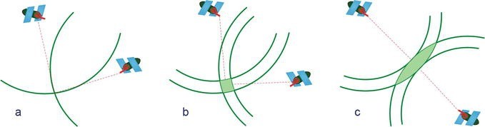
6. Dilution of precision - One parameter that is independent of the cleanliness of measurements but plays a role in the accuracy of position accuracy is the DOP. This factor depends on the geometry of visible satellites; the better the geometry is, the lower the DOP, and, hence, the better the position solution. Figure 4 visually depicts the concept of DOP. Figure 4(a) shows ideal case where signals from two satellites would form circles that intersect at the receiver position assuming the receiver has perfect measurements for the signal which is never true due to GNSS errors. Figure 4(b) represents a practical scenario in which uncertainty in measurement makes the virtual circuits radii a little ambiguous. The intersection region characterizes the area of possible receiver positions. This region could have a totally different shape as in Figure 4(c). This solely depends on the geometry of seen satellites. DOP is used to select which satellites should be included in position calculations. An ideal receiver would select only the set of satellites with the minimum DOP. The DOP number is unit-less, and calculating it requires knowing only the receiver and satellites’ positions, i.e., no measurements are needed. Hence, DOP could be computed before the journey to plan for trajectory data collection.
(Figure 4)

Slide 11
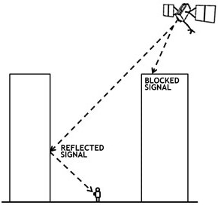
Factors affecting accuracy of satellite navigation systems
Satellites broadcast their signals in space with a certain accuracy, but what you receive depends on additional factors, including satellite geometry, signal blockage, atmospheric conditions, and receiver design features/quality.
Why does Satellite sometimes show me in the wrong place?
Many things can degrade satellite positioning accuracy. Common causes include:
Satellite signal blockage due to buildings, bridges, trees, etc.
Indoor or underground use
Signals reflected off buildings or walls ("multipath") Far less common causes may include:
Radio interference or jamming
Major solar storms
Satellite maintenance/maneuvers creating temporary gaps in coverage
Improperly designed devices that do not comply with GPS Interface Specifications
In many cases, a device's GPS hardware is working fine, but its mapping software is faulty. For example, users are often misled by:
Incorrectly drawn maps
Mislabeled businesses and other points of interest
Missing roads, buildings, communities, etc.
Incorrectly estimated street addresses
Notes:
Common Causes of Incorrect Positioning
Signal Blockage
Buildings, bridges, trees, tunnels, or indoor/underground locations
Multipath Errors
Signals reflect off surfaces like walls or buildings before reaching the receiver

Slide 12

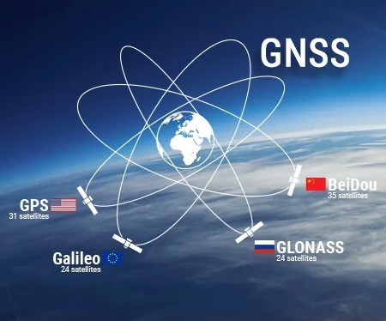
040 01 03: Examples of navigation systems:
Global Navigation Satellite System (GNSS) is a general term describing any satellite constellation that provides positioning, navigation, and timing (PNT) services on a global or regional basis.
Global Positioning System, is a U.S.-owned utility that provides users with positioning, navigation, and timing (PNT) services. This system consists of three segments: the space segment, the control segment, and the user segment. The U.S. Space Force develops, maintains, and operates the space and control segments.
The control segment consist of worldwide monitor and control stations that maintain the satellites in their proper orbits through occasional command maneuvers, and adjust the satellite clock. It tracks the GPS satellites, uploads updated navigational data, and maintains health and status of the satellite constellation.
Global Orbiting Navigation Satellite System (GLONASS), or Globalnaya Navigazionnaya Sputnikovaya Sistema, is a global GNSS owned and operated by the Russian Federation. The fully operational system consists of 24+ satellites.
BeiDou, or BDS, is a global GNSS owned and operated by the People's Republic of China. BDS was formally commissioned in 2020. The operational system consists of 35 satellites. BDS was previously called Compass.
Galileo, is a global GNSS owned and operated by the European Union. The EU declared the start of Galileo Initial Services in 2016 and plans to complete the system of 24+ satellites in 2021.
12

Slide 13
Other forms of navigation systems
Local area differential GNSS (WADGNSS)
Differential GNSS (DGNSS) is a kind of GNSS Augmentation system based on an enhancement to primary GNSS constellation(s) information by the use of a network of ground-based reference stations which enable the broadcasting of differential information to the user – also named rover – to improve the accuracy of the position – the integrity is not assured.
There are several DGNSS techniques, such as the classical DGNSS (or DGPS), the Real Time Kinematics (RTK) and the Wide Area RTK (WARTK).
Classical DGNSS
The standard DGNSS technique consists of the determination of the GNSS position from an accurately- surveyed position known as reference station.
The method takes advantage of the slow variation with time and user position of the errors due to ephemeris prediction, residual satellite clocks, ionospheric and tropospheric delays.
Starting from the reference station, the system computes and broadcasts either corrections to the GNSS position or to the pseudorange measurements to the DGNSS users. In order to be able to apply these corrections, the receiver has to be enabled for DGNSS and stay in the vicinity of the reference station to ensure that the two receivers (station and rover) observe the same GNSS satellite.
Other uncorrelated errors (e.g. multipath) cannot be corrected by this method and specific techniques have to be applied to mitigate them.
DGNSS accuracy is in the order of 1 m (1 sigma) for users in the range of few tens of kilometers from the reference station, growing at the rate of 1 m per 150 km of separation.
13
Notes:
These other form of navigation systems, they all serve the same purpose, to enhance or improve the position accuracy
Differential GNSS (DGNSS / WADGNSS)
Definition: Enhances standard GNSS by using ground-based reference stations to broadcast corrections to users (rovers).
Purpose: Improves position accuracy.
Limitations:
Integrity not guaranteed
Corrections only valid within tens of kilometers of reference station Classical DGNSS (DGPS)
Uses a surveyed reference station with a known location.
Sends corrections for satellite errors to nearby receivers.
Accuracy: ~1 meter for users within tens of kilometers

Slide 14
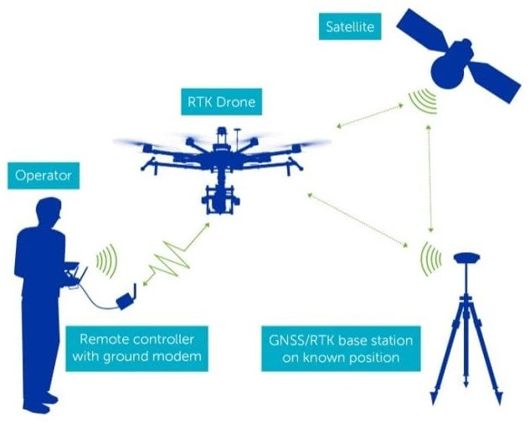
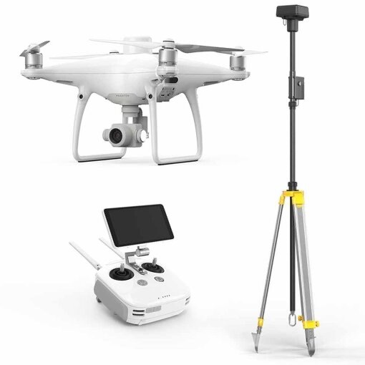
Real Time Kinematics (RTK)
Real Time Kinematics (RTK) is a differential GNSS technique originated in the mid-1990s that provides high performance positioning in the vicinity of a base station.
he technique is based on the use of carrier measurements and the transmission of corrections from the base station, whose location is well known, to the rover, so that the main errors that drive the stand-alone positioning cancel out. A RTK base station covers a service area spreading about 10 or 20 kilometres, and a real time communication channel is needed connecting base and rover. RTK, which achieves performances in the range of a few centimetres, is a technique commonly used in surveying applications.
The main limitations of RTK are as follows:
Limited range with respect to the base location.
The need of a communication channel for real time applications.
Some convergence time is needed to fix the phase ambiguities. This time depends on the processing algorithm and the distance between base and rover, and ranges from a few seconds to a few minutes.
In order to avoid re-initialization of the processing, the rover has to track the GNSS signals continuously. This makes the RTK not suitable for urban applications.
14
Notes:
Real Time Kinematics (RTK)
Developed in mid-1990s for high-precision positioning near a base station.
How it works:
Base station knows its exact location
Base sends corrections to the rover in real time
Uses carrier phase measurements for centimeter-level accuracy
Service area: ~10–20 km from base station
Common use: Surveying, precision mapping

Slide 15
Wide Area Kinematics (WARTK)
Starting in late 90's until nowadays, the group gAGE/UPC has developed the Wide-Area Real-Time Kinematics (WARTK) technique, which allows the extension of local services based on the real-time carrier phase ambiguity resolution to wide-area scale (i.e. baselines between the rover and reference stations greater than 100 km), for both dual-frequency (only GPS) and 3-frequency systems (also with Galileo and modernized GPS).
Notes:
Wide Area RTK (WARTK)
Extends RTK performance over a larger area
Broadcasts corrections over a wide network, allowing more users to achieve centimeter-level accuracy

Slide 16


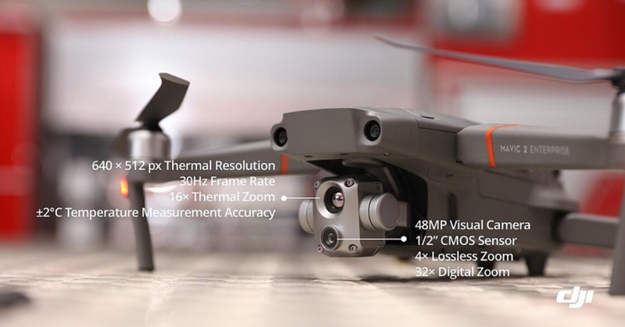
040 01 04: Other forms of guidance systems
Vision-based system
A Vision-based system is a vision system and, in most cases, consists of an image sensor, a processor module, a lens mount and a lens
Machine vision systems and algorithms represent an essential tool for several applications involving the use of
Unmanned Aerial Vehicles (UAVs)
On one side, these techniques are frequently used to recover information about the surrounding scene, meaning that visual cameras are payloads required to accomplish the mission goal.
This is the case of several civilian/military applications like infrastructure monitoring, surveillance of coastal areas
and 3D mapping
On the other side, visual technologies and algorithms play a key role in improving UAV inner functionality, e.g., in terms of autonomous guidance, navigation and control and situational awareness.
Notes:
Vision-Based Systems
Definition:
A vision-based system uses cameras and image sensors to collect visual information. Uses in UAVs
Mission Payload Applications
Recover information about the surrounding environment
Examples:
Infrastructure monitoring
Coastal area surveillance
3D mapping
Autonomous UAV Functionality
Helps the UAV see and understand its surroundings
Improves:
Guidance and navigation
Flight control
Situational awareness

Slide 17
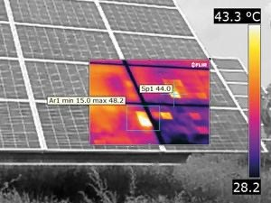
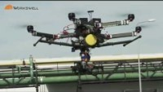
Infra-red (IR) system
Infrared radiation, which is a portion of the electromagnetic spectrum, is emitted by all objects with a temperature greater than absolute zero.
The amount of radiation emitted increases with the temperature of the object, and so variation in temperature
can be picked up by infrared sensors mounted to unmanned vehicles such as UAVs (unmanned aerial vehicles) and used to build up an image. Humans, animals and other heat sources will stand out against a cooler background.
Applications for unmanned thermal imaging systems include searching for and monitoring humans for security,
search and rescue, and law enforcement, as well as animals for wildlife conservation.
Thermal imaging can also be used to detect gas leaks and insulation failures and monitor the flow of heat energy for homes or industrial premises.
Large banks of solar panels can also be scanned quickly and efficiently for defects by a UAV equipped with a
thermal imaging camera payload.
Notes:
Infrared / Thermal Imaging Systems
Definition:
Infrared (IR) radiation is part of the electromagnetic spectrum.
All objects above absolute zero emit IR radiation.
Hotter objects emit more radiation, which can be detected by IR sensors.
How It Works on UAVs
IR sensors mounted on UAVs detect temperature differences.
Creates a thermal image where humans, animals, or heat sources stand out against cooler backgrounds.

Slide 18
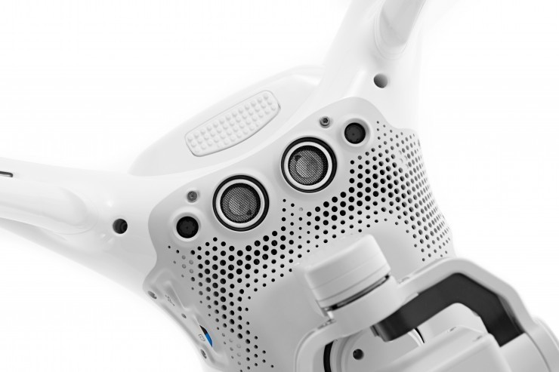
Ultrasound system
An ultrasonic sensor is an instrument that measures the distance to an object using ultrasonic sound waves.
An ultrasonic sensor uses a transducer to send and receive ultrasonic pulses that relay back information about an object’s proximity.
Ultrasonic sensors work by sending out a sound wave at a frequency above the range of human hearing. The transducer of the sensor acts as a microphone to receive and send the ultrasonic sound.
Most UAVs use the ultrasonic sensors on the bottom of the drone for detecting ground and also for use in terrain-
following. Drone proximity sensors assist with anti-collision, which will aid towards fewer crashes.
Ultrasonic Sensors are best used in the non-contact detection of:
Presence
Level
Position
Distance
Ultrasonics are Independent of:
Light
Smoke
Dust
Color
Material (except for soft surfaces, i.e. wool, because the surface absorbs the ultrasonic sound wave and doesn’t reflect sound.)
Notes:
Ultrasonic Sensors
Definition:
Measure distance to an object using ultrasonic sound waves (above human hearing).
Use a transducer to send and receive pulses that determine proximity. How They Work
Transmit: Sends out an ultrasonic sound wave
Receive: Echo bounces back to the transducer
Calculate distance: Based on the time it takes for the echo to return
Uses on UAVs
Terrain following → detecting ground level
Anti-collision → avoiding crashes
Non-contact detection of:
Presence of objects
Level or height
Position
Distance

Slide 19

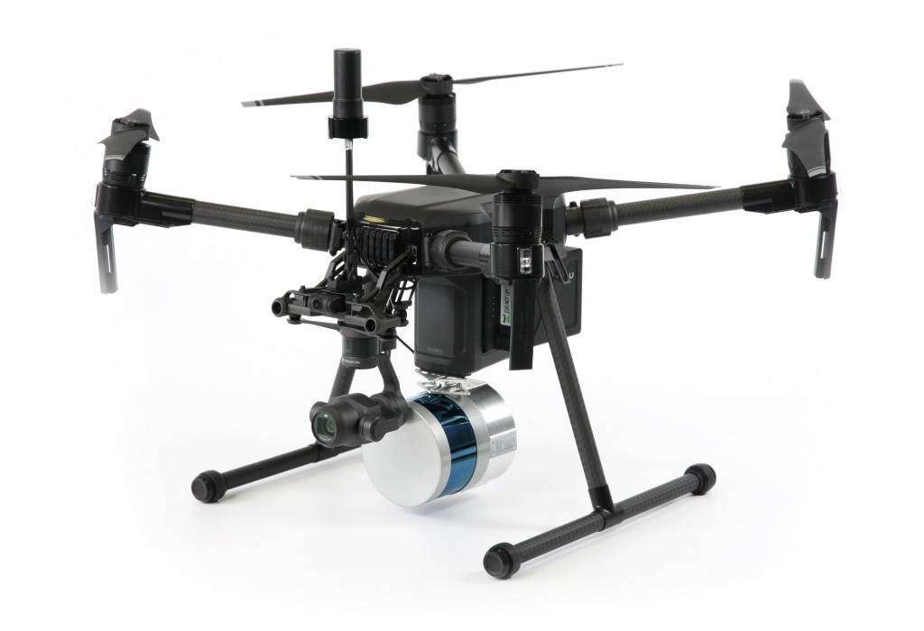
Light Detection and Ranging (LIDAR) system
LiDAR is fundamentally a distance technology. From an airplane or helicopter, LiDAR systems send light to the ground.
This pulse hits the ground and returns to the sensor. Then, it measures how long it takes for the light to return to
the sensor.
By recording the return time, this is how LiDAR measures distance. In fact, this is also how LiDAR got its name – Light Detection and Ranging.
Light Detection and Ranging (LiDAR) uses lasers to measure the elevation of features.
It’s a distance technology that samples with an incredible amount of accuracy and points.
It’s similar to sonar (sound waves) or radar (radio waves) because it sends a pulse and measures the time it takes to return. But LiDAR is different than sonar and radar because it uses light.
Notes:
LiDAR (Light Detection and Ranging)
Definition:
LiDAR measures distance using light (laser pulses).
Sends a laser pulse to the ground or object and measures time it takes to return.
How LiDAR Works
Transmit: Laser pulse is sent from UAV/aircraft
Reflect: Pulse hits the ground or object
Receive & Measure: Sensor measures return time → calculates distance
Similar to:
Sonar: uses sound waves
Radar: uses radio waves
Difference: LiDAR uses light for extremely accurate distance measurement
Applications of LiDAR
Measuring terrain elevation and 3D mapping
Generating high-precision point clouds
Surveying forests, buildings, infrastructure

Slide 20

040 02 00: Meteorology
040 02 01: Atmospheric properties and their effects on UA performance:
Pressure
Static Pressure - Air has substance (mass). Not very much if compared to other matter, but nevertheless a significant amount. As a result of the weight of the mass of air, pressure acts on all bodies in the atmosphere - this pressure is called static pressure.
always acts equally in all directions;
an aircraft always has static pressure acting on all surfaces;
static pressure decreases with increase of altitude;
static pressure at a given altitude will vary from day to day.
Dynamic Pressure - Because air has mass, air in motion possesses kinetic energy, and will exert a force on any object in the path of the moving air particles. Conversely, an object (such as an aircraft) in motion through the air will have a force exerted on it by the air. This force is called dynamic pressure.
acts only in the direction of movement
it is proportional to the density of the air and the square of the speed of the air.
The denser the air, the more air particles will hit the object in a given period of time. The greater the speed, the more air particles will hit the object in a given period of time
Notes:
UAs operate within the atmosphere, so air density, temperature, pressure, and humidity directly affect flight performance.
3. Pressure
Higher pressure → increased lift and engine performance
Lower pressure → decreased lift and engine performance

Slide 21
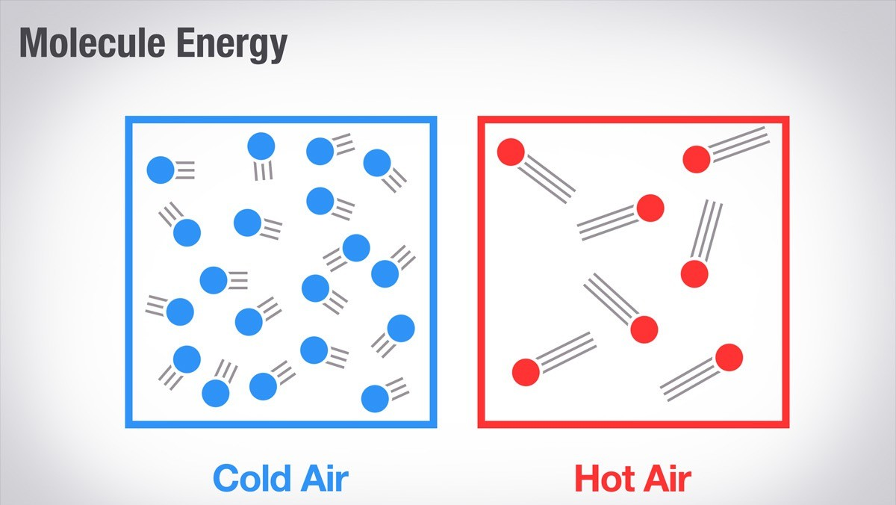
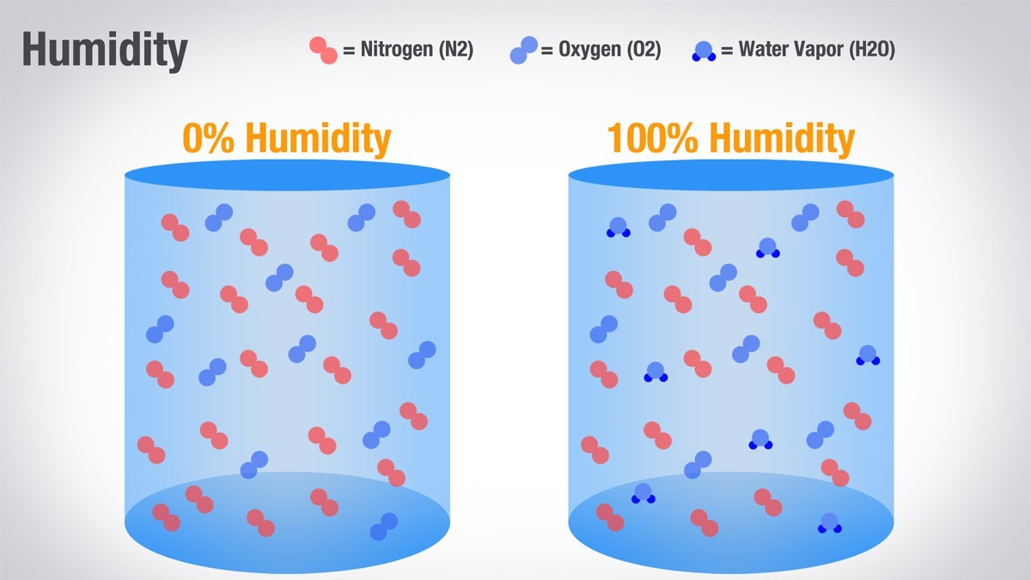
Temperature
The degree or intensity of heat present in a substance or object, especially as expressed according to a comparative scale and shown by a thermometer or perceived by touch.
High air temperatures affect the physics of how aircraft fly, meaning aircraft takeoff performance can be impaired on hot days.
Hot air is less dense than cold air, meaning aircraft require more engine power to generate the same amount of thrust and lift as they would in cooler climes.
Humidity
Is the concentration of water vapor present in the air
Humidity has a major affect on the way planes fly. This is due to the weight of the air when it is humid. When air is humid, it is actually lighter then dry air
If you take humid air (less dense), then the plane can no longer create the amount of lift it could when the air is dry (more dense). This causes pilots to have longer runways to gain speed before enough air is passing the wings per second to create enough lift, it also forces pilots to fly faster then would be required if the air were dry.
When you have more water vapor in the air, the air has less mass - which means it's less dense.
Notes:
2. Temperature
Hot air → less dense → reduces lift and engine/motor efficiency
Cold air → denser → improves lift and performance
4. Humidity
High humidity → slightly reduces air density → minor reduction in lift and performance
Low humidity → slightly higher air density → better performance

Slide 22



Density
The mass of the air per unit volume is called air density (“number” of air particles in a given space).
Air density is:
proportional to the static pressure;
inversely proportional to the temperature;
density decreases if humidity increases;
density decreases with increasing altitude (Static pressure and temperature decrease with altitude, but the effect of decreasing static pressure is dominant).
When density altitude is high, you’ll experience reduced aircraft performance. Because when the density altitude is high, the air is less dense, and your propellers become less efficient in thin air. As your density altitude increases, the performance of your UA decreases
A decrease in air density means a high density altitude; an increase in air density means a lower density altitude.
Fewer Air Particles
Less Lift
Notes:
1. Air Density
Thicker (denser) air → more lift and better propulsion efficiency
Thinner air (higher altitude, hotter temperature) → less lift, slower acceleration, and longer takeoff distance

Slide 23

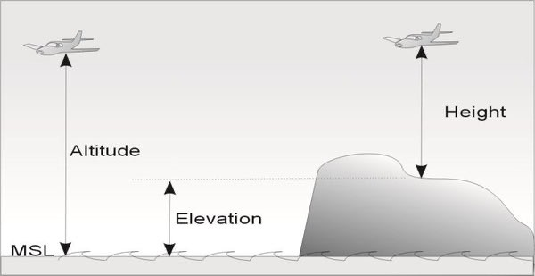
040 02 02: Basic altimetry terms:
Height – is a vertical distance between the aircraft and whatever surface.
Elevation – is a vertical distance from a datum, generally mean sea level, to a point or object on the earth's surface.
Altitude – is a vertical distance between a reference datum and a point or object.
Above Mean Sea Level (AMSL) – Is a measure of the vertical distance (height, elevation or altitude) of a location in reference to a historic mean sea level taken as a vertical datum.
Above Ground Level (AGL) – Describes the literal height above the ground over which you’re flying
Notes:
1. Height
Vertical distance between the aircraft and a surface below (e.g., ground, water, or object).
Used to describe how high the UA is flying above obstacles.
2. Elevation
Vertical distance from a reference datum, usually Mean Sea Level (MSL), to a point on the ground.
Example: Mountain elevation = 2,000 m AMSL
3. Altitude
Vertical distance between a reference datum and an aircraft or object.
Depends on the reference used (MSL, terrain, or airport).
4. Above Mean Sea Level (AMSL)
Height, elevation, or altitude measured relative to mean sea level.
Example: Airport elevation = 50 m AMSL
5. Above Ground Level (AGL)
Height measured directly above the ground under the aircraft.
Important for takeoff, landing, and obstacle clearance.

Slide 24


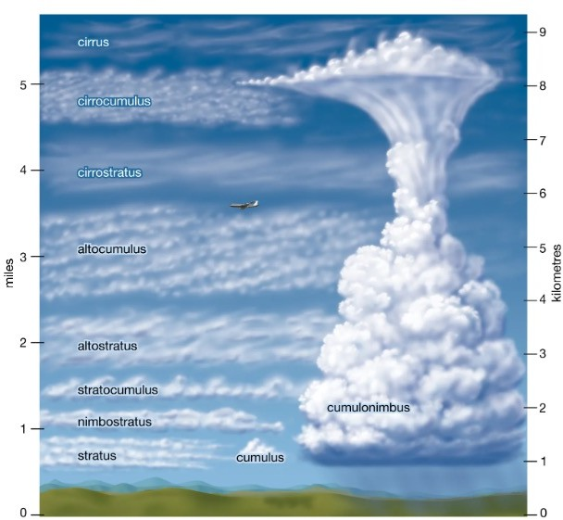

040 02 03: Characteristics of the cloud types:
Cumulus (CU)
Cumulus are clouds which have flat bases and are often described as "puffy", "cotton-like" or "fluffy" in appearance.
Cumulus clouds are low-level clouds, generally less than 2,000 m (6,600 ft) in altitude unless they are the more vertical cumulus congestus form.
Turbulence
Excites rapid pitching, rolling and vertical motions
Excites flexible modes – but typically small amplitude
Cumulonimbus (CB)
(from Latin cumulus, "heaped" and nimbus, "rainstorm") is a dense, towering vertical cloud, typically forming from water vapor condensing in the lower troposphere that builds upward carried by powerful buoyant air currents.
Form in the troposphere around 16,000m
In extreme case, it can reach the boundary between troposphere and stratosphere (tropopause) at 18000 meters
Radio interference
Lighting strikes
Reduced visibility
Severe wind shear

Slide 25

040 02 04: Different types of winds and their impact on UA ground speeds during operations:
Headwind
When the wind blows against the direction in which the aircraft moves it is called headwind.
Effects:
In aerodynamics, flying against the wind at a certain speed is equivalent to flying in calm air at an increased airspeed and reduced groundspeed.
Impact on Operations
During take off and landing, headwind increases the airflow, hence the necessary lift is achieved earlier and at lower speeds (the wind speed is added to the aircraft speed). As a result, less runway is required to perform a safe take off or landing. Therefore, headwind is more favourable for these phases of the flight.
A climb or descent in headwind conditions results in an increase of the gradient (i.e. the level change over the distance travelled) even though the rate of climb or descent (i.e. the level change over time) remains the same. As a result, aircraft reach their cleared levels earlier compared to the calm wind scenario.
In the cruise phase, having headwind means increased fuel burn (due to the increased drag) and increased flight time (due to the reduction in groundspeed). Operators try to avoid flying in headwind conditions whenever practicable by e.g. choosing an alternative route (which can be a bit longer but with less or no headwind) or choosing a different (normally lower) cruising level if the predicted windspeed is more favourable.
Resultant airspeed
Aircraft airspeed
Headwind
Resultant groundspeed
Notes:
Headwind
Definition
Wind blowing against the direction of aircraft movement.
Impact on Operations
Takeoff & Landing
Headwind increases airflow over the wings, producing lift sooner
Aircraft achieves necessary lift at lower groundspeed
Runway distance required is reduced → safer operations
Favourable for takeoff and landing
Climb & Descent
Gradient of climb/descent increases (level change per distance)
Rate of climb/descent over time stays the same
Aircraft reaches cleared levels earlier than in calm wind
Cruise Phase
Headwind → increased drag and fuel burn
Reduced groundspeed → longer flight time
Operators may choose alternate routes or different cruising levels to avoid strong headwinds

Slide 26

Tailwind
When the wind blows in the same direction as the aircraft moves, it is called tailwind.
Effects:
Flying in tailwind conditions increases the groundspeed and reduces the airspeed of an aircraft.
Impact on Operations
During take off and landing, tailwinds reduce the airflow. Consequently, the necessary lift is achieved later and at higher speeds (the wind speed is added to the aircraft speed). Therefore, longer runways are required to perform a safe take off or landing. Another factor to be considered is that in case of rejected take off, the speed of the aircraft will generally be higher, so it will need more distance to decelerate. Take offs and landings with tailwind component exceeding certain value (usually 10 kts) are avoided (the precise value may differ depending on the aircraft type and other factors, e.g. runway surface condition).
A climb or descent in tailwind conditions results in a reduced gradient (i.e. the level change over the distance travelled) even though the rate of climb or descent (i.e. the level change over time) remains the same. Hence, aircraft reach their cleared levels later compared to the calm wind scenario. This may lead to e.g. an aircraft not being able to reach its expected level at the transfer of control point which in turn may contribute to a loss of separation.
In the cruise phase, tailwinds make flights more efficient by reducing fuel burn (due to the reduced drag). Another effect is that flight time is reduced. While this is generally considered advantageous, it may have the side effect of overloading certain ATC sectors. Also, reaching the destination aerodrome faster sometimes means more time will be spent in the holding stack. Nevertheless, the overall impact of tailwind on the cruise phase is considered beneficial.
Resultant airspeed
Aircraft airspeed
Tailwind
Resultant groundspeed
Notes:
Tailwind
Definition
Wind blowing in the same direction as the aircraft
Impact on Operations
Takeoff & Landing
Tailwind reduces airflow over the wings, so lift is achieved later and at higher groundspeed
Longer runway required for safe takeoff or landing
Rejected takeoff → higher speed, more distance needed to stop
Tailwinds above certain limits (e.g., 10 kts) are generally avoided
Climb & Descent
Gradient of climb/descent decreases (level change per distance)
Rate of climb/descent over time stays the same
Aircraft may reach cleared levels later → potential ATC separation issues
Cruise Phase
Tailwind → reduced drag and fuel burn
Faster flight time → sometimes leads to earlier arrival at congested airspace or holding stacks
Overall beneficial for efficiency

Slide 27
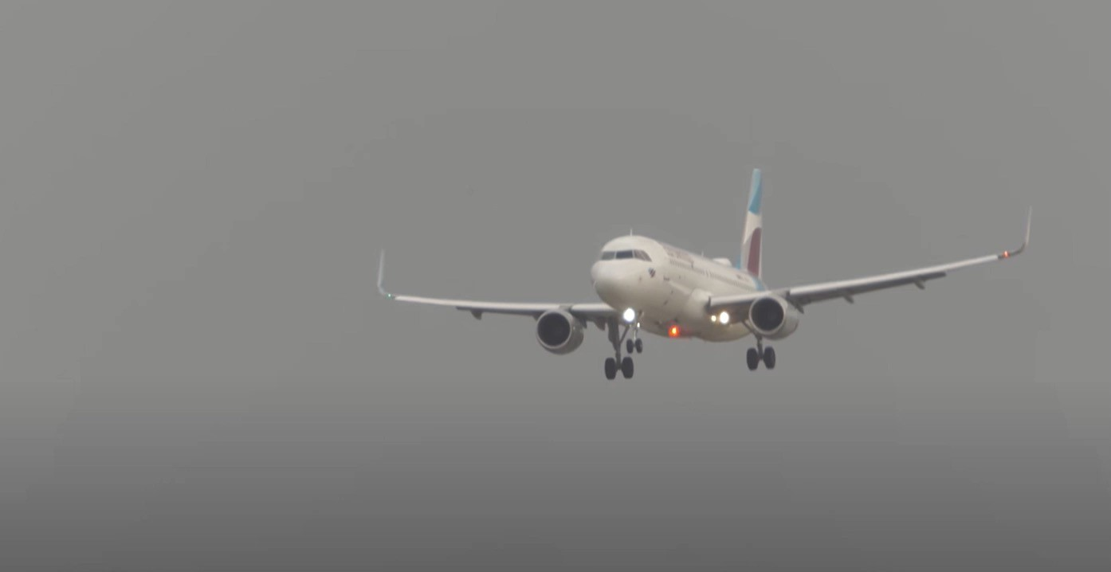



Crosswind
Is any wind that has a perpendicular component to the line or direction of travel
Effects:
Create trajectory slip (wind will push the aircraft off the desired track)
Impact on Operations
In aviation, a crosswind is the component of wind that is blowing across the runway, making landings and take-offs more difficult than if the wind were blowing straight down the runway. If a crosswind is strong enough, it can damage an aircraft's undercarriage upon landing.
Crosswind
Notes:
Crosswind
Definition
Any wind that has a perpendicular component to the aircraft’s direction of travel.
Essentially, the wind pushes the aircraft sideways.
Impact on Operations
Takeoff & Landing
Crosswinds make takeoff and landing more challenging
Aircraft can drift off runway centerline
Strong crosswinds may damage the landing gear if not properly managed
In-flight Adjustments
Pilots use rudder and aileron inputs to counteract crosswind drift
Important for stability, safety, and maintaining intended track

Slide 28
040 02 05: How to obtain and interpret reliable weather information:
Meteorological Services Singapore (non-aviation)
Meteorological Service Singapore (MSS) mission is to observe and understand the weather and climate affecting Singapore and to provide services in support of national needs and international co-operation. It collects and maintain reliable long-term national weather records, provides reliable weather and climate services. It also conducts research to advance understanding and prediction of the weather and climate of Singapore and the region. It does risk and impact assessment of natural environmental hazards
The key departments within MSS are:
Centre for Climate Research Singapore (CCRS). CCRS does tropical climate and weather research focusing on the Southeast Asia region.
Meteorological Systems Department (MSD). MSD provides support for meteorological equipment, computer systems and key installations in order to meet MSS's operational and technical requirements.
Risk and Resource Department (RRD). RRD analyses risks and assesses their impact from the corporate/organisational angle as well as those pertaining to environmental /natural hazards.
Weather Services Department (WSD). WSD provides weather forecasts, warnings, monitoring and assessment. It provides such information to critical sectors like the civil aviation, military, maritime, private/public agencies and the general public.

Slide 29


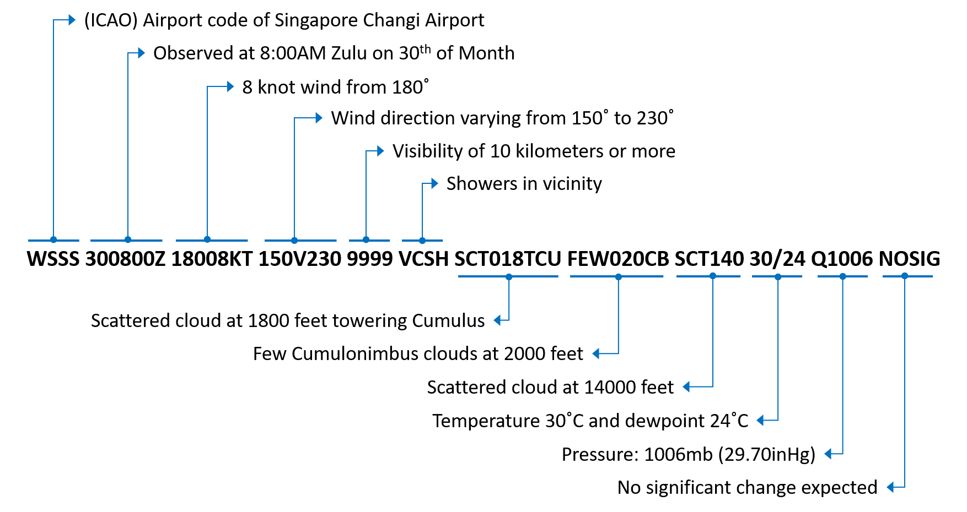

Meteorological Terminal Air Report (METAR)
Meteorological Terminal Air Report, Literally ‘Meteorological Terminal Air Report’ or more straightforwardly ‘Routine aerodrome meteorological report’. Contains observations of current visibility and other weather conditions from the ground. It Is only good for the current hour. Used by aviators to gain essential knowledge about flying conditions.
Use initial code letters to identify the type of report.
METARL reports – routine hourly report, is issued at the end of each hour.
SPECI – indicates a special , unscheduled report. Usually happens for special conditions like low visibility and thunderstorms
TAF – means Terminal Aerodrome Forecast. It is similar to METAR but less common and used to provide a forecast for a general area.
MyENV (NEA app as an alternative to METAR)
Use the app to get the latest environmental updates and information at your fingertips based
on your current location with MyENV
Access real-time information on Singapore’s weather and air quality including weather forecasts, PSI readings and UV index.
Subscribe to receive location-specific alerts on
heavy rainfall, lightning and dengue clusters
The app can be downloaded on App store or Google Play store
METAR Data (Raw)

Slide 30

050 00 00: Human Factors
Module 5

Slide 31









050 01 00: Human Factors in Aviation
050 01 01: Understand the SHELL model
SHELL Model – A conceptual model developed to understand the relationships between aviation system resources/environment and the human component.
One practical diagram to illustrate this conceptual model uses blocks to represent the different components of Human Factors. This building block diagram does not cover the interfaces which are outside Human Factors (hardware-hardware; hardware-environment; software-hardware) and is only intended as a basic aid to understanding Human Factors:
Components
The human operator is the most critical and flexible component in the system,
H
Hardware
interacting directly with other system components.
S
L
E
Software
Liveware
Environment
L
Liveware
Notes:
SHELL Model – Human Factors in Aviation
Definition
A conceptual model used to understand how humans interact with aviation systems and the environment.
Helps identify how the human operator interacts with other system components.

Slide 32
050 01 00: Human Factors in Aviation
050 01 01: Understand the SHELL model
Software - the rules, procedures, written documents etc., which are part of the standard operating procedures.
Hardware - the Air Traffic Control suites, their configuration, controls and surfaces, displays and functional systems.
Environment - the situation in which the L-H-S system must function, the social and economic climate as well as the natural environment.
Liveware - the human beings - the controller with other controllers, flight crews, engineers and maintenance personnel, management and administration people - within in the system.
A mismatch between the Liveware and other four components contributes to human error. Thus, these interactions must be assessed and considered in all sectors of the aviation system.
Notes:
S – Software
Procedures, manuals, checklists, regulations, and documentation
How humans interact with written or digital instructions
H – Hardware
Physical tools, aircraft, instruments, and equipment
How humans physically operate and interact with machines
E – Environment
External conditions: weather, temperature, noise, terrain, air traffic
How surroundings affect human performance
L – Liveware
The human operator (pilot, crew, UAV operator)
Central to the system; interacts with all other components
L – Liveware (others)
Other people in the system: co-pilots, ATC, maintenance personnel
Human-to-human interactions and communication

Slide 33














050 01 00: Human Factors in Aviation
050 01 01: Understand the SHELL model
Component interfaces
Liveware - Software
Operator to Data
Knowledge and Skills
User-friendliness of Documents
Design and Interpretations
Interface Mismatches
Ambiguous symbology and/or confusing documents
Notes:
The interaction Liveware and software interface, is the interaction between human and data
Like how human interpret the checklists, rules and regulations
mismatch in this type of interaction can happen due to, misinterpretation of manuals, documents, checklists or inappropriate procedures

Slide 34




050 01 00: Human Factors in Aviation
050 01 01: Understand the SHELL model
Component interfaces
Operator to Machine
User reaction to aviation systems
Liveware - Hardware
Physical Features
Configurations, controls, displays, systems
and functional
Interface Mismatches
Poorly designed equipment, instrument location, and warning systems
Notes:
Next is the interaction between the liveware and hardware.
It is the interaction between the human and machines, tools, equipment and instruments
Mismatch can happen when:
there is lack of tools or the person is not famillar with the tolls, equipment of instruments

Slide 35






050 01 00: Human Factors in Aviation
050 01 01: Understand the SHELL model
Component interfaces
Liveware - Environment
Operator to Environment
Environment
Discomfort, Distraction, Weather
Sun lighting(glare, heat), wind turbulence, sound and rain
Interface Mismatches
Perceptual errors, visual illusions
Notes:
Next comes with the interaction between liveware and environment
It is the interaction between the human and organisational environment
It relates to effect of lighting conditions, noise levels and temperature on humans
Mismatch of any of this can cause an accident.

Slide 36





050 01 00: Human Factors in Aviation
050 01 01: Understand the SHELL model
Component interfaces
Operator to Crew
Liveware - Liveware
Pilot, observers, management
Teamwork
Leadership,
coordination, cooperation and
communication
Interface Mismatches
Poor communication and imbalance of authority
Notes:
Last is the interaction between the liveware and liveware
It is the interaction between humans in the aviation systems, for example, technician and supervisor or engineer
Mismatches can occur due to lack of communication or lack of management support.

Slide 37






050 02 00: Physiology – Vision
050 02 01: Visual illusions during UAS operations:
Autokinesis
The autokinetic effect (also referred to as autokinesis) is a phenomenon of visual perception in which a stationary, small point of light in an otherwise dark or featureless environment appears to move. It presumably occurs because motion perception is always relative to some reference point. In darkness or in a featureless environment there is no reference point, so the movement of the single point is undefined.
To prevent this illusion, focus the eyes on objects at varying distances and avoid fixating on one target. Be sure to maintain a normal scan pattern.
View a target with a reference to stationary structures or landmarks.
Notes:
Autokinesis (Autokinetic Effect)
Definition
A visual illusion where a stationary light appears to move when viewed in dark or featureless environments.
Happens because motion perception needs a reference point. Without nearby objects, the brain interprets the light as moving.
In darkness or empty spaces, there’s no reference, so a single light seems to drift or move.
How to Prevent Autokinesis
Do not stare at one light; keep scanning the area.
Focus on objects at different distances to maintain a visual reference.
Use stationary landmarks or structures if available.
Maintain a normal scan pattern rather than fixating on one point.

Slide 38
050 02 00: Physiology – Vision
050 02 01: Visual illusions during UAS operations:
Disorientation
The farther away a UA gets from those operating it, the harder it can be to determine the features of the aircraft that provide clues about its orientation.
When you first discover that you no longer have knowledge of the direction in which your drone is pointing, stop and make small control inputs to confirm the actual aircraft where its heading.
Notes:
Definition
Disorientation occurs when the operator loses visual reference of the UA’s orientation.
The farther the UA is, the harder it is to tell which way it is pointing.
Why It Happens
Lack of visible features or reference points on the UA
Distance makes it difficult to determine front/back or left/right
Can lead to incorrect control inputs and unintended maneuvers
How to Correct Disorientation
Stop large movements of the UA
Make small control inputs to test its actual heading
Re-establish orientation before resuming normal flight
Consider return-to-home or orientation aids if available

Slide 39
050 02 00: Physiology – Vision
050 02 01: Visual illusions during UAS operations:
Spatial Disorientation
Spatial disorientation specifically refers to the lack of orientation with regard to the position, attitude, or movement of the aircraft in space. It is a state of temporary confusion resulting from misleading information being sent to the brain by various sensory organs.
The best way to overcome spatial disorientation is with training and by trusting the controls, instruments(by checking the telemetry regularly during flight), and disregarding the sensory perceptions.
Notes:
Definition
Loss of awareness of the UA’s position, attitude, or movement in space.
Caused by misleading sensory inputs (eyes, inner ear, motion perception).
Can lead to confusion and incorrect control inputs.
Causes
Flying in low visibility (fog, night, or featureless terrain)
Rapid maneuvers without visual references
Conflicting vestibular and visual signals
How to Overcome Spatial Disorientation
Training – practice recognizing and responding to disorientation
Trust instruments and telemetry – focus on what the flight controller shows
Ignore misleading sensory perceptions – do not rely solely on what you feel or see

Slide 40



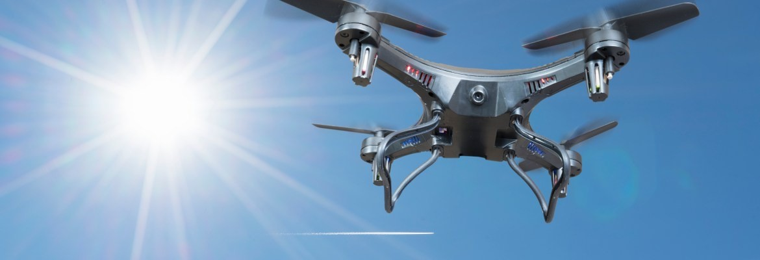
050 02 02: Effects of sun-blindness and how to overcome it
Sun-Blindness is when the glare of the sun is blinding the pilot’s view. Flying directly toward a rising or setting sun can effectively blind you, making it impossible for you to track your UA or see obstacles or other UA.
Similar degradation to vision can occur when the sun reflects off of objects such as mirrored glass windows.
To overcome this, , try to set up the mission to avoid having to look into the sun, keeping it behind the ground control station, and wear sunglasses and choose a hat with a broad brim.
Notes:
Definition
Temporary visual impairment caused by glare from the sun.
Flying toward a rising or setting sun can make it hard or impossible to see the UA or obstacles.
Other Causes
Sun reflecting off mirrored windows, water, or shiny surfaces
How to Overcome Sun-Blindness
Plan missions to avoid looking directly into the sun
Keep the sun behind the ground control station
Wear sunglasses to reduce glare
Use a hat with a broad brim for additional shading

Slide 41

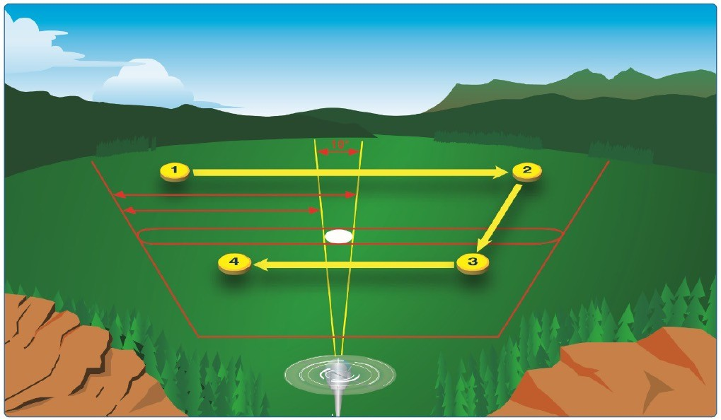
050 02 03: Visual scanning techniques
Visual Scanning Technique
To scan effectively, pilots must look from right to left or left to right
begin scanning at the greatest distance an object can be perceived (top) and move inward toward the position of the aircraft (bottom).
For each stop, an area approximately 30° wide should be scanned
The duration of each stop is based on the degree of detail that is required
No stop should last longer than 2 to 3 seconds
When moving from one viewing point to the next, pilots should overlap the previous field of view by 10°

Slide 42



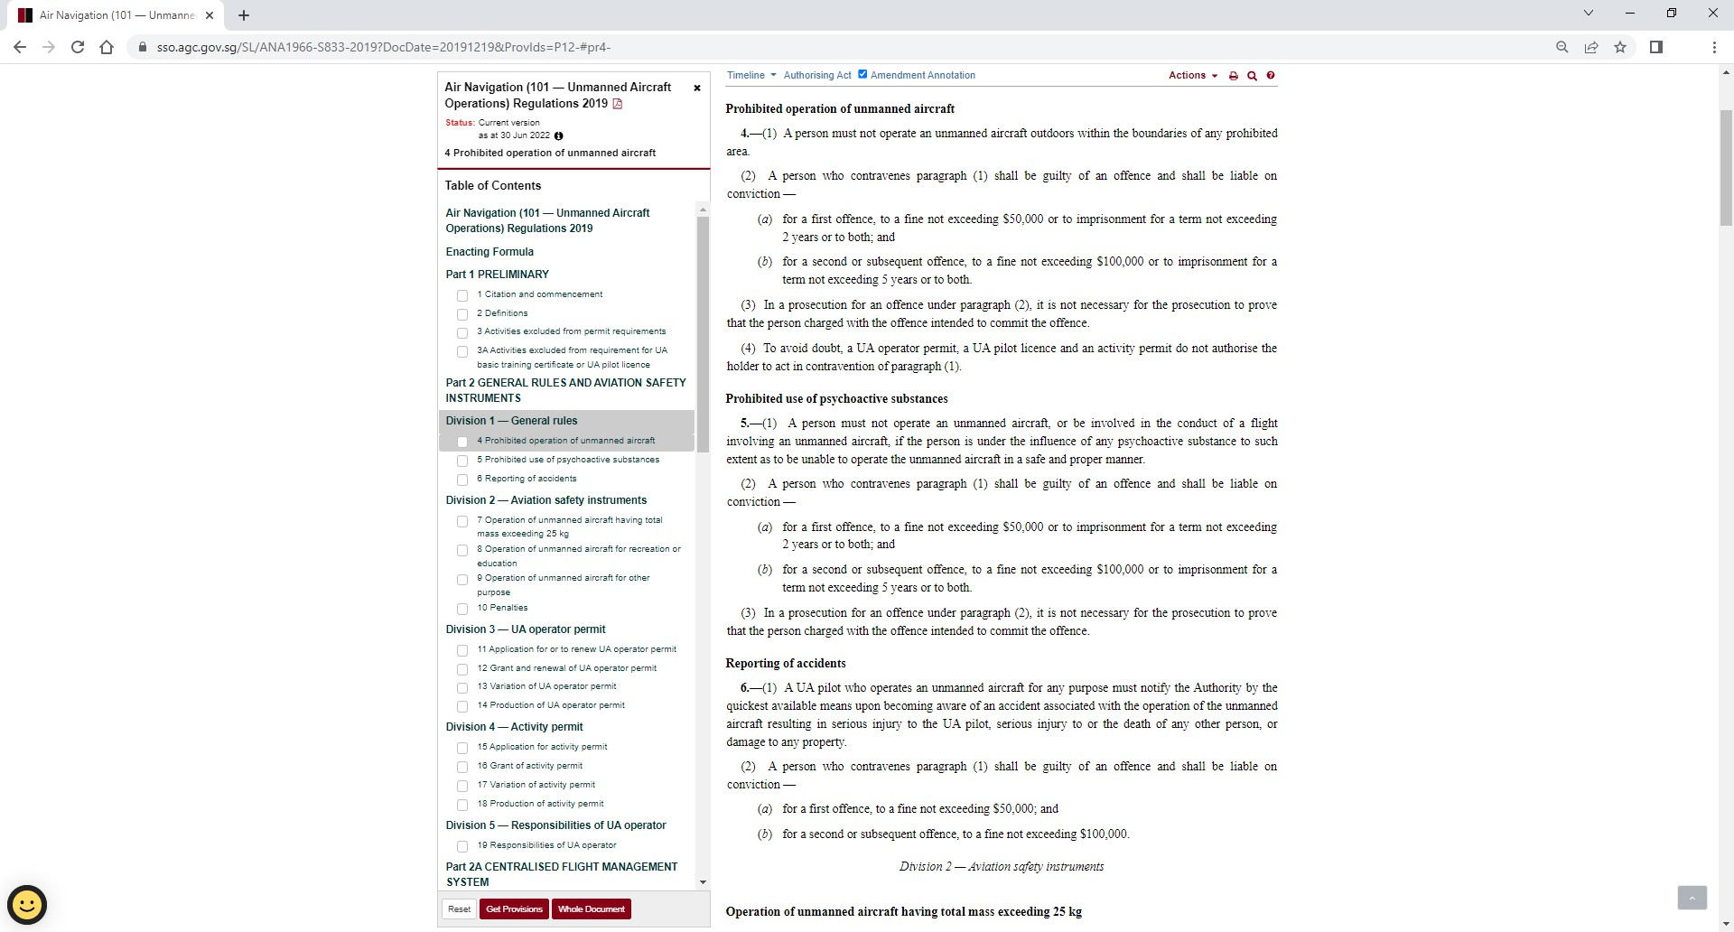
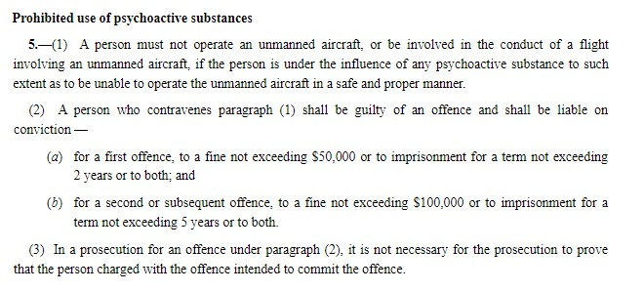
050 03 00: Physiology – Medications and Psychoactive Substances
050 03 01: Prohibition of use of psychoactive substances during UAS operations

Slide 43
050 03 02: Effects of intoxication during UAS operations
When alcohol is consumed, it is very rapidly absorbed into the blood and tissues of the body but the process of detoxification is quite slow. The impairing effects of alcohol are apparent quite soon after ingestion but it takes about 3 hours for the effects of 1 ounce of alcohol to wear off. Nothing, inclusive of sleep, coffee or exercise, will speed up this process or minimise the effects of the alcohol.
It has been recently determined that alcohol is absorbed into the fluid of the inner ear and will stay there after it has been eliminated from the blood, brain and body tissues. Since the inner ear affects balance, the presence of alcohol within the vestibular apparatus can lead to spatial disorientation and the potential of vertigo.
The presence of alcohol in the blood interferes with the normal absorption of oxygen by the tissues and can result in hypoxia.
Hypoxia is defined as a lack of oxygen in the body tissues. This can be caused either by a shortage of oxygen in the air being breathed or by a number of physiological/pathological issues affecting blood circulation or the quantity of oxygen carried by haemoglobin in the blood.
The effects of hypoxia include fatigue, confusion, euphoria, inability to concentrate, impaired decision-making, impaired psychomotor performance, loss of consciousness and, eventually, death.
Notes:
Hypoxia
Alcohol interferes with oxygen absorption in tissues, potentially causing hypoxia.
Hypoxia = lack of oxygen in body tissues
Causes of hypoxia:
Low oxygen in the air
Blood circulation issues
Reduced oxygen-carrying capacity of hemoglobin
Effects of Hypoxia
Fatigue
Confusion
Euphoria
Inability to concentrate
Impaired decision-making
Impaired psychomotor performance
Loss of consciousness
Death (in severe cases)

Slide 44
050 03 03: Effects of medications during UAS operations
Both prescription and non-prescription (over-the-counter) drugs can impair judgement and degrade coordination.
Common side effects of many non-prescription drugs, such as cold tablets, cough mixtures, antihistamines, appetite suppressors, and laxatives, include drowsiness, confusion, blurred vision, and dizziness.
Drugs can also have a cumulative effect and, if more than one drug is taken at the same time, the combined negative effect may be well in excess of that of the individual drugs.
Likewise, prescription drugs such as antibiotics or antidepressants can have a pronounced effect on judgement, mental acuity, and coordination.
Please note that when taking non-prescribed drugs, make sure that there are no side effects.
Notes:
Both can have a negative affect on the ability to fly safely

Slide 45



050 04 00: Psychology – Fatigue
050 04 01: Causes of fatigue
Like stress, fatigue falls into two broad categories: acute and chronic.
Acute fatigue is short-term and is a normal occurrence in everyday living. It is the kind of tiredness people feel after a period of strenuous effort, excitement, or lack of sleep. Rest after exertion and 8 hours of sound sleep ordinarily cure this condition.
Acute fatigue has many causes, but the following are among the most important for the pilot:
Mild hypoxia (oxygen deficiency)
Physical stress
Psychological stress
Depletion of physical energy
Notes:
Definition
Fatigue is a state of physical and/or mental weariness that reduces performance and alertness.
Like stress, it is classified into two types:
Acute Fatigue
Short-term tiredness from daily activities, exercise, excitement, or lack of sleep.
Usually recovered with rest and 8 hours of good sleep.

Slide 46
050 04 00: Psychology – Fatigue
050 04 01: Causes of fatigue
Chronic fatigue, extending over a long period of time, usually has psychological roots, although an underlying disease is sometimes responsible. Continuous high-stress levels produce chronic fatigue.
An individual may experience this condition in the form of weakness, tiredness, palpitations of the heart, breathlessness, headaches, or irritability.
Sometimes chronic fatigue even creates stomach or intestinal problems and generalized aches and pains throughout the body.
When the condition becomes serious enough, it leads to emotional illness.
Notes:
Chronic Fatigue (for reference)
Long-term fatigue caused by persistent stress, insufficient rest, or ongoing workload.
Recovery requires more than a single night’s rest and may need lifestyle adjustments.

Slide 47

050 04 02: Effects of fatigue on UAS operations
Fatigue is frequently associated with pilot error.
Some of the effects of fatigue include degradation of attention and concentration, impaired coordination, and decreased ability to communicate. These factors seriously influence the ability to make effective decisions.
If suffering from acute fatigue, a pilot should not operate UA.
If fatigue occurs during the operation of UA, no amount of training or experience can overcome the detrimental effects. Getting adequate rest is the only way to prevent fatigue from occurring
Avoid flying UA without a full night’s rest, after working excessive hours, or after an especially exhausting or stressful day
UA pilots who suspect they are suffering from chronic fatigue should consult a physician.

Slide 48

050 04 03: Fatigue management techniques
Acute fatigue can be prevented by:
proper diet
adequate rest and sleep
A well-balanced diet prevents the body from needing to consume its own tissues as an energy source.
Adequate rest maintains the body’s store of vital energy.
Chronic fatigue is not relieved by proper diet and adequate rest and sleep and usually requires treatment by a physician.

Slide 49





050 05 00: Psychology – Stress
050 05 01: Causes of stress
Every person has experienced some form of stress in his or her life, but understanding exactly what stress is and how it affects an individual’s performance can be difficult. A situation that is stressful for one person may not be stressful for another. Sometimes stress can enhance performance, but many times it negatively affects how a flight crew member performs a task.
Physical stress - Conditions associated with the environment, such as temperature and humidity extremes, noise, vibration, and lack of oxygen.
Physiological stress - Physical conditions, such as fatigue, lack of physical fitness, sleep loss, missed meals (leading to low blood sugar levels), and illness.
Psychological stress - Social or emotional factors, such as a death in the family, a divorce, a sick child, or a demotion at work. This type of stress may also be related to mental workloads, such as analyzing a problem, navigating an aircraft, or making decisions.
The persistence and/or duration of a stressful event or situation define whether the stress is acute or chronic. Physical and mental reactions to these types of stress can be very different.
Acute Stress is the type of stress that triggers a “fight or flight” response in an individual, whether the threat is real or imagined. Normally, a healthy person can cope with acute stress and prevent stress overload. However, ongoing acute stress can develop into chronic stress.
Chronic Stress can be defined as a level of stress that presents an intolerable burden, exceeds the ability of an individual to cope, and causes individual performance to fall sharply. Unrelenting psychological pressures, such as loneliness, financial worries, and relationship or work problems can produce a cumulative level of stress that exceeds a person’s ability to cope with the situation.
Notes:
Types of Stressors
Physical Stress
Environmental factors: extreme temperature, humidity, noise, vibration, low oxygen
Physiological Stress
Body-related conditions: fatigue, lack of fitness, sleep loss, missed meals, illness
Psychological Stress
Social or emotional factors: death in family, divorce, sick child, job problems
Mental workload: problem-solving, navigation, decision-making
Acute Stress
Short-term, triggers “fight or flight” response
Normally manageable by healthy individuals
Can develop into chronic stress if persistent
Chronic Stress
Long-term, exceeds coping ability
Causes performance to drop sharply
Examples: loneliness, financial worries, work or relationship problems

Slide 50

050 05 02: Effects of stress on UAS operations
Excessive stress levels reduce performance. Increases in over-stimulation is generally proportional to decreases in performance. Some of the typical effects that occur in stressful situations include:
Difficulty concentrating and reduced vigilance - easily distracted
performance falls off rapidly
Tendency to cut corners, skip items and look for the easiest way out
Either slowness (due to lack of interest) or hyperactivity (due to adrenaline)
Focusing on easily manageable details while ignoring serious threats
Tendency to pass the responsibility on to others
Fixation on single issues or even a mental block
Increase in risk-taking leading to an increase in the number of violations, especially when frustrated with failures
Excessively hurried actions - Due to adrenaline and alertness level, there is a tendency to act very quickly even when there is no time pressure. Hurried actions increase the chance of errors.

Slide 51

050 05 03: Stress management techniques
stress can be managed by strategies such as:
Maintaining good physical fitness and bodily function.
Engaging in a program of regular physical exercise.
Getting enough sleep to prevent fatigue.
Eating a balanced diet.
Learning and practicing relaxation techniques.

Slide 52

060 00 00: Safety & Operations
Module 6

Slide 53


060 01 00: Operational Risks and Hazards
060 01 01: Define risk and hazard
A Hazard is any existing or potential condition that can lead to injury, illness, or death to people; damage to or loss of a system, equipment, or property; or damage to the environment.
The Risk is what may happen should a hazard manifest itself, that is, what may happen if your operations interact with any particular obstacle.
Notes:
Hazard
Any existing or potential condition that can cause:
Injury, illness, or death to people
Damage or loss of systems, equipment, or property
Environmental harm
Risk
The chance of something happening if a hazard is encountered
What could happen if your operations interact with a hazard or obstacle

Slide 54

Identify risk and hazards using 5 risk elements
There are 5 important risk elements to check before flying UA, to ensure safe operation.
Pilot – The pilot's fitness to fly must be evaluated including competency in the airplane, currency, and flight experience.
Aircraft – The aircraft's performance, limitations, equipment, and airworthiness must be determined.
Environment – Factors, such as weather, airport conditions, and the availability of air traffic control services must be examined.
Operation – The purpose of the flight is a factor which influences the pilot's decision on undertaking or continuing the flight.
Situation – To maintain situational awareness, an accurate perception must be attained of how the pilot, airplane, environment, and operation combine to affect the flight.
Notes:
5 Key Risk Elements for Safe UA Operation
Pilot
Evaluate the pilot’s fitness to fly
Consider competency, recent flight experience, and currency
Aircraft
Check aircraft performance, limitations, equipment, and airworthiness
Environment
Assess weather conditions, airport/runway conditions, and ATC availability
Operation
Consider the purpose of the flight and whether it influences the decision to fly
Situation
Maintain situational awareness
Understand how pilot, aircraft, environment, and operation interact

Slide 55
060 01 02: Identify Risk and hazards using the following models:
PAVE model
In the first step, the goal is to develop situational awareness by perceiving hazards, which are present events, objects, or circumstances that could contribute to an undesired future event. In this step, the pilot will systematically identify and list hazards associated with all aspects of the flight: Pilot, Aircraft, enVironment, and External pressures, which makes up the PAVE checklist.
The PAVE Checklist
Another way to mitigate risk is to perceive hazards. By incorporating the PAVE checklist into preflight planning. With the PAVE checklist, pilots have a simple way to remember each category to examine for risk prior to each flight.
Once a pilot identifies the risks of a flight, he or she needs to decide whether the risk or combination of risks, can be managed safely and successfully. If not, make the decision to cancel the flight. If the pilot decides to continue with the flight, he or she should develop strategies to mitigate the risks. One way a pilot can control the risks is to set personal minimums for items in each risk category. These are limits unique to that individual pilot’s current level of experience and proficiency.
P = Pilot in Command (PIC) - The pilot is one of the risk factors in a flight. The pilot must ask, “Am I ready for this flight?” in terms of experience, recency, currency, and physical, and emotional condition. The IMSAFE checklist provides the answers.
A = Aircraft - What limitations will the aircraft impose upon the trip? Ask the following questions:
Is this the right aircraft for the flight?
Am I familiar with and current in this aircraft?
Is this aircraft equipped for the flight? Instruments? Lights? Is navigation and communication equipment adequate?
Can this aircraft carry the planned load?
Can this aircraft operate at the altitudes needed for the operation?
Notes:
The PAVE model helps pilots identify and manage risks before a flight. It focuses on four key areas:
Pilot (P)
Evaluate yourself: experience, recency, currency, physical and emotional condition
Use the IMSAFE checklist to answer: “Am I ready for this flight?”
Example questions:
Am I rested?
Am I healthy?
Am I emotionally stable?
Aircraft (A)
Check aircraft limitations and suitability for the mission
Example questions:
Is this the right aircraft for the flight?
Am I familiar with this aircraft?
Is it equipped properly? (instruments, lights, navigation, communication)
Can it carry the planned load?
Can it operate at the required altitudes?

Slide 56
V = EnVironment
Weather is a major environmental consideration. Earlier it was suggested pilots set their own personal minimums, especially when it comes to weather. As pilots evaluate the weather for a particular flight, they should consider the following:
What is the current ceiling and visibility? In mountainous terrain, consider having higher minimums for ceiling and visibility, particularly if the terrain is unfamiliar.
Consider the possibility that the weather may be different than the forecast.
Consider the winds at the airports being used and the strength of the crosswind component.
If flying in mountainous terrain, consider whether there are strong winds aloft. Strong winds in mountainous terrain can cause severe turbulence and be very hazardous for aircraft even when there is no other significant weather.
Are there any thunderstorms present or forecast?
Terrain
Airspace
Check the airspace(No-Fly zones) and any temporary flight restriction (TFR).
Notes:
V = enVironment
Weather
Check ceiling and visibility; higher minimums in unfamiliar or mountainous terrain
Consider forecast accuracy – weather may change
Check winds at departure and destination airports, including crosswind components
Be aware of strong winds aloft in mountainous areas – can cause turbulence
Look out for thunderstorms
Terrain
Be aware of obstacles and mountainous areas that may affect flight safety
Airspace
Check for No-Fly Zones and any Temporary Flight Restrictions (TFRs)

Slide 57
E = External Pressures - External pressures are influences external to the flight that create a sense of pressure to complete a flight—often at the expense of safety. Factors that can be external pressures include the following:
Someone waiting at the airport for the flight’s arrival
The desire to demonstrate pilot qualifications
The desire to impress someone (Probably the two most dangerous words in aviation are “Watch this!”)
The desire to satisfy a specific personal goal (“get home-itis,” “get-there-itis,” and “let’s-go-itis”)
The pilot’s general goal-completion orientation
Emotional pressure associated with acknowledging that skill and experience levels may be lower than a pilot would like them to be. Pride can be a powerful external factor!
Notes:
E = External Pressures
External pressures are outside influences that may push a pilot to take risks
Common examples:
Someone waiting at the airport
Desire to demonstrate skill or impress others (“Watch this!”)
Personal goals like “get-home-itis” or “let’s-go-itis”
Pride and emotional pressure from acknowledging limited skill or experience

Slide 58
IMSAFE checklist
One of the best ways single pilots can mitigate risk is to use the IMSAFE checklist to determine physical and mental readiness for flying:
Illness — Am I sick? Illness is an obvious pilot risk.
Medication — Am I taking any medicines that might affect my judgment or make me drowsy?
Stress — Am I under psychological pressure from the job? health, or family problems? Stress causes concentration and performance problems. While the regulations list medical conditions that require grounding, stress is not among them. The pilot should consider the effects of stress on performance.
Alcohol — Have I been drinking within 8 hours? Within 24 hours? As little as one ounce of liquor, one bottle of beer, or four ounces of wine can impair flying skills. Alcohol also renders a pilot more susceptible to disorientation and hypoxia.
Fatigue — Am I tired and not adequately rested? Fatigue continues to be one of the most insidious hazards to flight safety, as it may not be apparent to a pilot until serious errors are made.
Emotion — Am I emotionally upset?
Notes:
A simple way for pilots to check their physical and mental readiness before flight:
I – Illness
Am I sick? Even minor illness can affect judgment and control.
M – Medication
Am I taking any medicine that could cause drowsiness or affect performance?
S – Stress
Am I under pressure from work, family, or personal issues?
Stress can reduce concentration and decision-making.
A – Alcohol
Have I consumed alcohol in the last 8 or 24 hours?
Even small amounts can impair flying skills, increase risk of disorientation and hypoxia.
F – Fatigue
Am I tired or not fully rested?
Fatigue is a hidden hazard that can lead to serious errors.
E – Emotion
Am I emotionally upset?
Strong emotions can affect focus and judgment.

Slide 59
060 01 03: General steps to perform risk assessment
1. Identify Hazards
Find anything that could cause injury, damage, or loss (e.g., obstacles, weather, equipment).
2. Assess Risks
Evaluate the likelihood and severity of each hazard.
3. Mitigate Risks
Take action to reduce or control the risk (e.g., change flight path, adjust altitude, use safety gear).
4. Monitor and Review
Continuously observe conditions and be ready to adapt or abort the flight if risks change.

Slide 60

Importance of making sound aeronautical decisions:
Aeronautical decision-making (ADM) is decision-making in a unique environment—aviation. It is a systematic approach to the mental process used by pilots to consistently determine the best course of action in response to a given set of circumstances. It is what a pilot intends to do based on the latest information he or she has.
Using the acronym “DECIDE,” the six-step process DECIDE Model is another continuous loop process that provides the pilot with a logical way of making decisions. DECIDE means to Detect, Estimate, Choose a course of action, Identify solutions, Do the necessary actions, and Evaluate the effects of the actions
Detect – The decision maker detects the fact that change has occurred
Estimate – The decision maker estimates the need to counter or react to the change.
Choose – The decision maker chooses a desirable outcome (in terms of success) for the flight.
Identify – The decision maker identifies actions which could successfully control the change.
Do – The decision maker takes the necessary action.
Evaluate – the decision maker evaluates the effect(s) of his/her action countering the change.
Notes:
ADM is decision-making in aviation.
Pilots use it to systematically choose the best action based on the latest information.
It is a continuous process of evaluating situations and responding safely.
DECIDE Model (6 Steps)
Detect – Notice that a change or problem has occurred.
Estimate – Determine how serious the change is and if it requires action.
Choose – Pick the best course of action to handle the situation.
Identify – Identify possible solutions to control or fix the issue.
Do – Carry out the chosen action.
Evaluate – Check if the action worked and make further adjustments if needed.

Slide 61
060 02 02: Importance of making sound aeronautical decisions:
Perceive, Process, Perform (3P) Model
The Perceive, Process, Perform (3P) model for ADM offers a simple, practical, and systematic approach that can be used during all phases of flight. To use it, the pilot will:
Perceive the given set of circumstances for a flight
Process by evaluating their impact on flight safety
Perform by implementing the best course of action
Use the Perceive, Process, Perform, and Evaluate method as a continuous model for every aeronautical decision that you make. Although human beings will inevitably make mistakes, anything that you can do to recognize and minimize potential threats to your safety will make you a better pilot.
Notes:
3P is closely similar to the DECIDE model
1. Perceive — Identify Hazards
The pilot perceives the current situation by gathering information about:
Pilot (health, readiness, workload)
Aircraft (condition, performance, limitations)
Environment (weather, airspace, terrain, obstacles)
External pressures (mission goals, time pressure, expectations)
2. Process — Assess the Impact
The pilot processes the information by evaluating how the identified hazards may affect safety. Consider the consequences, risks, and the time available to respond.
3. Perform — Take Action
The pilot performs the best course of action by:
Implementing risk controls
Choosing safer alternatives
Adjusting the plan or modifying the operation
Communicating and executing decisions effectively

Slide 62




060 02 03: The dangers of Get-Home-Itis mindsets on UAS operations
Mental Conversations
“If that other guy made it, then so can I!”
“I’m almost there, let’s just do it and get it over with.”
“I don’t want to divert — too much work.”
“I’ve done this before, I can do it again.”
“I can handle this. I’ve got 20 years of experience on my side.”
“I’m so tired, I just want to get home!”
“GET ME HOME-ITIS”; the danger behind it is very real. It is when the desire to get to a destination overrides logic, sound decision-making, and basic instinct.
Notes:
“Get-Me-Home-Itis” (Get-There-Itis)
This is one of the most dangerous psychological traps in aviation. It occurs when the desire to reach the destination overrides:
logic
situational awareness
decision-making
safety procedures
established personal minimums
Pilots push forward despite knowing the risks, often leading to accidents during the final stages of a mission.

Slide 63

060 02 04: Crew resource management (CRM) and how it can contribute to safety of UAS operations
Crew Resource Management (CRM)
Crew Resource Management (CRM) is the effective use of all available resources for flight crew personnel to assure a safe and efficient operation, reducing error, avoiding stress and increasing efficiency.
CRM is concerned not so much with the technical knowledge and skills required to fly and operate an aircraft but rather with the cognitive and interpersonal skills needed to manage the flight within an organised aviation system.
Notes:
The very main concept of CRM is to utilise all the resources a a pilot to reduce human error, avoid or mitigate stress and fatigue, enhance decision making, improve communication and teamwork and increase operational efficiency and safety

Slide 64
060 02 05: 5 hazardous attitudes that may impact the safety of UAS operations:
Being fit to fly depends on more than just a pilot’s physical condition and recent experience. For example, attitude affects the quality of decisions. Attitude is a motivational predisposition to respond to people, situations, or events in a given manner.
Hazardous attitudes contribute to poor pilot judgment but can be effectively counteracted by redirecting the hazardous attitude so that correct action can be taken. Recognition of hazardous thoughts is the first step toward neutralizing them.
Anti-authority - This is the teenage equivalent of “don't tell me what to do” attitude. The rules are there for a reason. The antidote for this is, “Follow the rules, they are usually right”.
Impulsivity - This is the “act first, think later” attitude. Acting impulsively is not safe and can put you or yourself at risk. The antidote for this is, “Not so fast. Think first”.
Invulnerability - This is the “It won't happen to me” attitude. A person with this attitude could think that they are invincible, indestructible, but we both know this isn't true. The antidote for this is “It could happen to me”.
Macho - This is the “I can do it - I'll show them”. Pilots with this attitude try to prove themselves by taking risks in order to impress others. The antidote for this is, “Takin chances is foolish”.
Resignation - This is the “what's the use?” attitude. Pilots with these thoughts often think that when things are going well that it is just good luck. The antidote for this is, "I'm not helpless, I can make a difference”.
Notes:
1. Anti-Authority
Definition: A “Don’t tell me what to do” mindset. Pilots may feel rules, instructions, or procedures do not apply to them.
Danger: Ignoring rules leads to unsafe shortcuts and poor decision-making.
2. Impulsivity
Definition: A tendency to act without thinking—“Do something quickly!” or “Act first, think later.”
Danger: Quick, unconsidered actions can lead to serious operational errors and accidents.
3. Invulnerability
Definition: The belief that accidents happen to others, not to oneself—“It won’t happen to me.”
Danger: Leads to unnecessary risk-taking because the pilot underestimates hazards.
4. Macho
Definition: The mindset of trying to prove oneself—“I can do it!” / “Watch this!” A desire to show skill or impress others by taking risks.
Danger: Encourages pushing limits and performing unsafe actions.
5. Resignation
Definition: Feeling helpless—“What’s the use?” or “I can’t make a difference.” Pilots give up control and rely on luck.
Danger: Reduced assertiveness, poor problem-solving, and failure to take corrective action.

Slide 65

060 03 00: UAS Operations
060 03 01: Common phases and describe the checks conducted and/or considerations for each phase:
1. Flight planning and management considerations
The flight plan is the technical plan for the execution of each flight that meets the legal and safety requirements pertaining to:
Regulatory requirements
Airworthiness of aircraft
Weight limitations (amount of weight the specific aircraft can carry)
Route and altitude requirements
Starting point (Take-off point)
Ending point (Landing point)
The direction of travel (Flightpath)
Distance to travel (Maximum range)
Aircraft speed
Aircraft battery/Fuel capacity (Maximum endurance)
Environment (Map of Location & weather conditions)
Alternate landing if problem arises (Emergency procedures)
Observers (crew personnel)
Position of the pilot where it can maintain a visual line of sight

Slide 66
060 03 00: UAS Operations
060 03 01: Common phases and describe the checks conducted and/or considerations for each phase:
Contingency/Emergency planning considerations
An emergency situation is one in which the safety of the UA or of persons or on the ground is endangered for any reason. At the emergency planning stage, it is important that the relevant individuals or groups be asked to participate. Members of the team can include:
Safety officer
Employees with knowledge of the work
Supervisor of the area of work
It is also important to identify what are the technical, human and natural hazards that may pose a threat during the operation. The following are examples of the hazards associated with the normal operation of UA:
Mid-air collision with other UA / structure(s)
Loss of UA control in-flight due to strong wind or turbulence
UA catches fire during flight
Uncontrolled crash landing
Others (e.g. collision with other property, environmental considerations, etc)

Slide 67
060 03 00: UAS Operations
060 03 01: Common phases and describe the checks conducted and/or considerations for each phase:
Having identified the hazards, the possible major impacts should be itemized, such as:
Sequential events (e.g. a fire after an explosion)
Evacuation
Casualties
Damage to property
Disruption of work
Based on the events, the required actions are determined. For example:
Declare emergency (sound alert)
Evacuate the danger zone
For minor injuries, first aid shall be administered to the casualty
For major injuries, the casualty shall be transported to the nearest identified hospital and call for ambulance if necessary.

Slide 68
060 03 00: UAS Operations
060 03 01: Common phases and describe the checks conducted and/or considerations for each phase:
Also, consider what resources are required, such as:
Medical supplies
Auxiliary communication equipment
Firefighting equipment
Trained personnel
Transport

Slide 69
060 03 00: UAS Operations
060 03 01: Common phases and describe the checks conducted and/or considerations for each phase:
3. Pre-flight
In aviation, a preflight checklist is a list of tasks that should be performed prior to takeoff. Its purpose is to improve flight safety by ensuring that no important tasks are forgotten.
Before the day of flight
Immediately Before Flight
Check Weather Conditions
Aircraft Batteries Charged
Controller Charged
Firmware Updated
App Updated
Flight Route / Area Planned
Site Survey / Obstacle Check
Obtain Required Permissions / Permits
Equipment Packed
All Equipment Brought
Inspect UA for faults
Notified Airspace Authority
Notify individuals nearby operations
Home point set, including Return to Home (RTH) Height
Lens Cover Removed
Gimbal Clamp Removed
Check Signal Strength
Check Satellite Strength

Slide 70
060 03 00: UAS Operations
060 03 01: Common phases and describe the checks conducted and/or considerations for each phase:
In-flight
Always check the status of your UA through the mobile app interface or by the LED light. Check the drone manuals as some drones will flash RED lights if there are unusual things that happen, it maybe a firmware malfunction, signal issues or the battery is running low. If these things happen immediately land your UA.
Confirm aircraft mode performance
Monitor battery performance
Land on the same location where take-off was performed

Slide 71
060 03 00: UAS Operations
060 03 01: Common phases and describe the checks conducted and/or considerations for each phase:
Post-flight
The drone may have been damaged during the last flight, check each component for small cracks or other visual damage and make note of any repairs that are necessary if any. Here are some post-flight checklists:
Airframe or shell no signs of cracks and damage
Propellers are free from dirt, and no signs of cracks
Motors are smoothly running
The camera and gimbals are properly intact
Indicator lights
No missing or loose screws
Batteries cool down and are free from any sign of damage
Landing gears are intact and no sign of damage

Slide 72

060 03 02: Importance of contingency/emergency procedures and the common handling procedures:
Having a contingency plan minimizes the impact of unforeseen events and outlines a plan for carrying out normal operation workflow without any disruption. A contingency plan is commonly known as a backup plan, a disaster recovery plan, or fondly, “plan B”. The importance of contingency plan are:
Helps minimize damage: When there is a plan B in place, you are in a better position to react to events and minimize damage.
Improved Reactivity: The primary reason for planning is the improved reactivity it brings to the table. As a contingency plan clearly lays action steps one needs to take to overcome the obstacle, you can quickly react to the situation without thinking about it too much or worse, panicking.
Bounce back quickly: Since you know exactly what to do when a disaster strikes, you can quickly tackle any challenge and bounce back to normal in no time. Contingency plans, therefore, ensure your progress is not hampered for longer than necessary.
Gives you confidence: Once you have a plan in place for tackling any challenge life throws your way, things become a lot easier to handle. Having a contingency plan in place helps boost your and your team’s confidence as you already know what to do in case disaster strikes. Being prepared reduces ambiguity and fear of the unknown.

Slide 73

060 03 02: Common handling procedures:
Loss of GPS
If GPS signal is lost in flight. “Return to home and Intelligent Flight mode will no be functional”
Common handling Procedure:
Switch to “A” or “ATTI” mode to disable GPS
Continue flight without GPS
Find a safe landing area and perform manual landing and shutdown
Notes:
"If the GPS signal is lost during flight, the drone won’t be able to use Return-to-Home or any intelligent flight modes. In this case, you switch to ATTI mode to fly manually. Keep control, look for a safe area, and land the drone carefully by yourself."

Slide 74
060 03 02: Common handling procedures:
Loss of Power
Loss of power is when the UA does not have sufficient power to stay airborne due to power supply-related failures. This may lead to a sudden shutdown of the UA during mid-flight. Hence, should stop the flight operation and land the UA ASAP.
Common handling Procedure:
Maintain visual contact with aircraft
Immediately return the aircraft to your landing
If disoriented:
Use RTH (manually )or Set RTH when a certain battery percentage is met. (e.g., 15%)
If strong winds prevent return flight:
USE camera to locate suitable divert locations and LAND aircraft
Notes:
"Loss of power happens when the drone doesn’t have enough power to stay in the air, which can cause it to shut down mid-flight.
If this happens, keep visual contact, return to the landing spot immediately, or use manual RTH if needed. If the wind is strong, use the camera to find a safe place nearby and land the drone safely."

Slide 75
060 03 02: Common handling procedures:
Loss of C2 link
“Loss of C2 link” defines as the loss of command and control link between the UA and the ground station (controller). If this link cannot be established, there is a possibility that the drone will crash into an obstacle or fly away on its own. In any case, a drone that cannot be controlled by its pilot poses a hazard to other aircraft, as well as people and property on the ground.
Common handling Procedure:
Maintain visual contact with the aircraft
Verify remote controller is powered on
Move toward aircraft if possible
Setting an RTH (built-in feature for handling a lost link – the Return to Home (RTH) function. When RTH kicks in, the drone will automatically fly to a pre-determined location at a set altitude.)
IF unable to re-establish link:
Alert the Authority about the incident.
Notes:
"Loss of C2 link happens when the drone loses communication with the remote controller. This can make the drone fly away or crash, which is dangerous. If it happens, keep visual contact, check that the controller is on, move toward the drone if possible, and use the Return to Home (RTH) function. If the link cannot be restored, report the incident to the authorities."

Slide 76
060 03 02: Common handling procedures:
Fly away
Basically, anything that can weaken the link between the drone and controller can cause a flyaway.
Common handling procedure:
Maintain visual contact with aircraft Verify remote controller is powered on Continue to maintain visual of aircraft Alert the authority about the incident
Setting an RTH (built-in feature for handling a lost link – the Return to Home (RTH) function. When RTH kicks in, the drone will automatically fly to a pre-determined location at a set altitude.)
Notes:
"A flyaway happens when the drone loses connection with the controller or its signals are weakened, causing it to fly away uncontrollably. If this occurs, keep visual contact with the drone, make sure the controller is on, and use the Return to Home (RTH) function if available. If the drone cannot be controlled, immediately alert the authorities."

Slide 77
060 03 02: Common handling procedures:
Stall
Stalls in fixed-wing flight are often experienced as a sudden reduction in lift as the pilot increases the wing's angle of attack and exceeds its critical angle of attack (which may be due to slowing down below stall speed in level flight).
Common handling procedure:
Use the PRAR for stall recovery
Pitch nose down to reduce angle of attack
Reduce banking by levelling the wings
Add power as needed
Return to the desired flight path
Notes:
A stall happens when the wing’s angle of attack becomes too steep, causing a sudden loss of lift. To recover, use the PRAR method:
pitch the nose down to reduce the angle,
level the wings to reduce bank,
add power if needed,
and then return to the desired flight path."

Slide 78
060 03 03: Difference between maintenance and flight checks
Flight checks are taken from the manuals or instructions of the manufacturer (eg. Pre- flight, in-flight and post-flight) and it covers the critical UA sub-systems such as propulsion system, power system, command & control system, navigation & flight control system, as well as the overall structure integrity.
While,” as well as Maintenance means, inspection, overhaul, repair, preservation, and the replacement of partspreventive maintenance. Maintenance can basically be divided into two parts: scheduled maintenance and unscheduled maintenance.

Slide 79
Importance of keeping a maintenance log
The importance of keeping a maintenance log is to record all maintenance, both scheduled and unscheduled, conducted on the UAS. As the maintenance log is also used to keep track the configuration of the UA, each UA should have its dedicated maintenance logbook with a unique identifier assigned to it.
We need to record all these logs for easy troubleshooting of damages and to avoid unintentionally UA crash for safe operation.
Notes:
Keeping a maintenance log is important because it records all maintenance, both scheduled and unscheduled, on the UA. Each drone should have its own log with a unique identifier. These records help track the aircraft’s configuration, make troubleshooting easier, and ensure safe operation to prevent accidents."

Slide 80
UAS owners and operators or anyone that is conducting a repair should follow the (OEM) guidelines.
Importance of following original equipment manufacturer (OEM)
As (OEM) guidelines have the specifications and equipment to make the right replacement parts for the damaged UA.
Failure to do so may lead to potentially devastating consequences for safety, UA performance and flight characteristics due to the non-fully compatibility of the replaced components or components that is not originally designed for the UA.
Notes:
"It is important to follow the Original Equipment Manufacturer (OEM) guidelines when repairing or maintaining a UA. OEM guidelines provide the correct specifications and approved parts for the aircraft. Using non-approved parts or ignoring these guidelines can compromise safety, reduce UA performance, and negatively affect flight characteristics because the components may not be fully compatible."

